Slide 1


KSBi-BIML 2023
Analysis of Spatially resolved transcriptomics

Slide 2
Welcome to Spatial Transcriptomic session
R/Python script, objects, power point slides and can be downloaded here:
https://www.dropbox.com/sh/v4k9hvwlwhab8pz/AAC3ta-o_LdawSGQ_--2UWdDa?dl=0
Steps | File name | Input/Output
chapter 5 single cell reference | BIML_sc_allen_cortex.rds | chapter 5, 6 input
chapter 5 processed visium data | BIML_visium_brain_processed.rds | chapter 5 output
chapter 5 processed visium data | BIML_visium_cortex_processed.rds | chapter 5 output
chapter 6 spacexr doublet mode metadata | BIML_spacexr_cortex_doubletmode.csv | chapter 6 output
chapter 6 spacexr full mode assay | BIML_spacexr_cortex_fullmode.csv | chapter 6 output
chapter 6 spacexr/seurat meta 저장된 visium | BIML_visium_cortex_annotated.rds | chapter 7, 8 input
chapter 7 conda environment info | environment.yml | chapter 7 python environment
chapter 7 anndata | BIML_visium_cortex_anndata.h5ad | chapter 7 input/output
chapter 7 jupyter notebook | BIML_chapter7_squidpy_code.ipynb | chapter 7 python script
chapter 8 visium json | BIML_scalefactors_json.json | chapter 8 input
chapter 8 cellchat prop calculated object | BIML_visium_cortex_prob_cellchat.rds | chapter 8 output
chapter 9 stutility input folder | BIML_visium_STutility_input_files | chapter 9 input
chapter 9 stutility object | BIML_visium_cortex_stutility.rds | chapter 9 output
Input files and python script highlighted with purple should be downloaded before starting analysis
Please make a directory for this analysis and save necessary objects at the directory
Set the directory before we start analysis

Slide 3
Table of Contents
Chapter 1 | What is R programming?
Chapter 2 | Then why python?
Chapter 3 | What is single cell RNA-seq and spatial transcriptomics?
Chapter 4 | What is Space Ranger?
Chapter 5 | Integrative analysis of spatial datasets - Seurat
Chapter 6 | Decomposition/Mapping analysis – Seurat/SpaceXR
Chapter 7 | Neighborhood analyis and co-occurrence - Squidpy
Chapter 8 | Cell-cell interaction - CellChat
Chapter 9 | Visualization of blended spatial plot of several features – STutility
Chapter 10 | Summary
Chapter 11 | Q&A
Exercise

Slide 4
1. What is R programming?

Slide 5



What is R and Why R?
R is used widely in biological research and provides a solid
platform for beginner scientific programmers.
It’s free and open-source.
Bioconductor uses the R statistical programming language and is open source and open development.
Modified from : https://datacarpentry.org/semester-biology/about/why-r/
https://www.bioconductor.org/

Slide 6
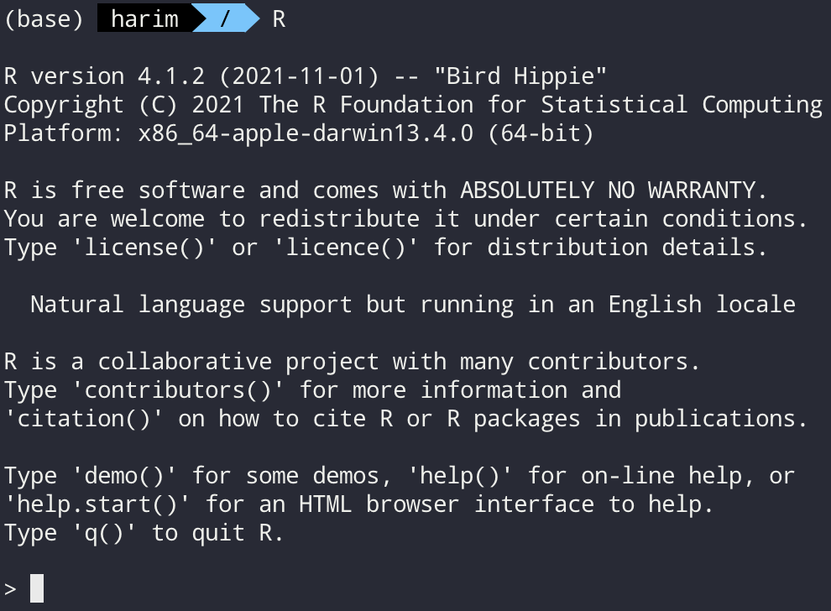
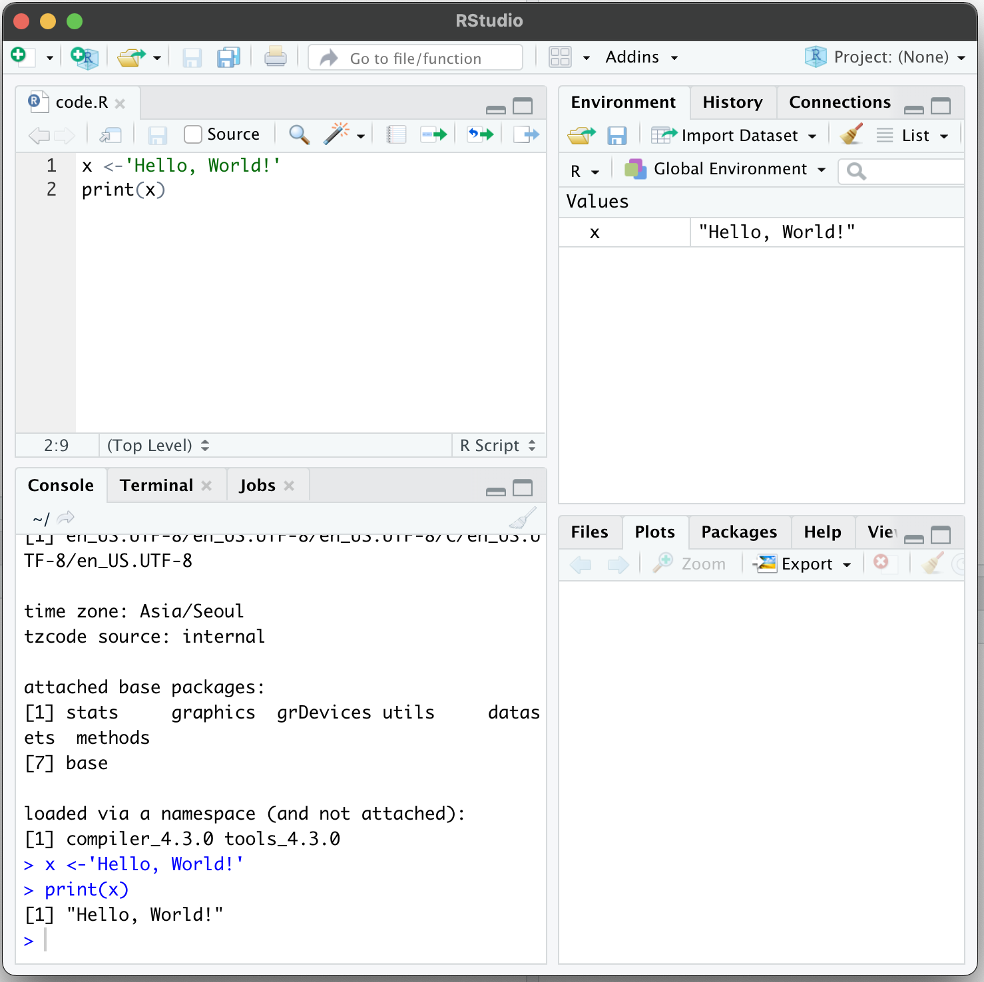
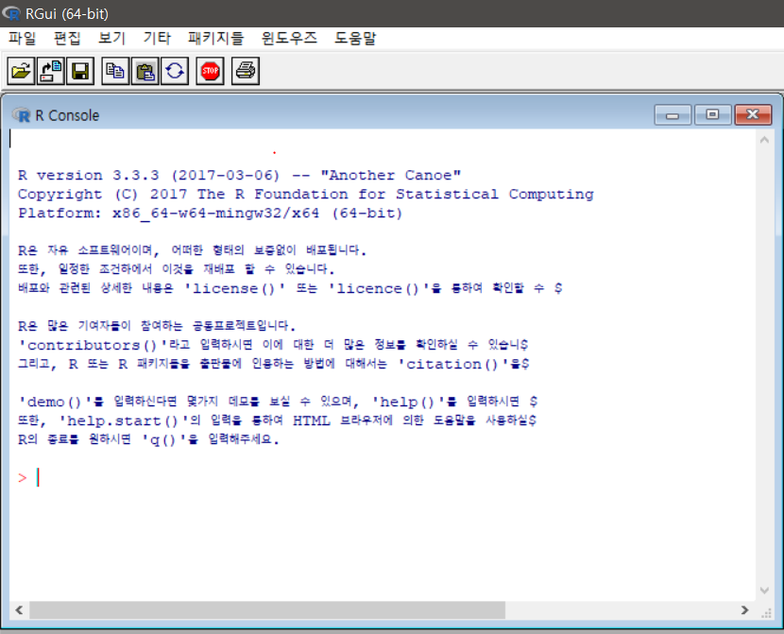
Several ways to use R
Command line Interface
Rstudio
Graphical user interface

Slide 7
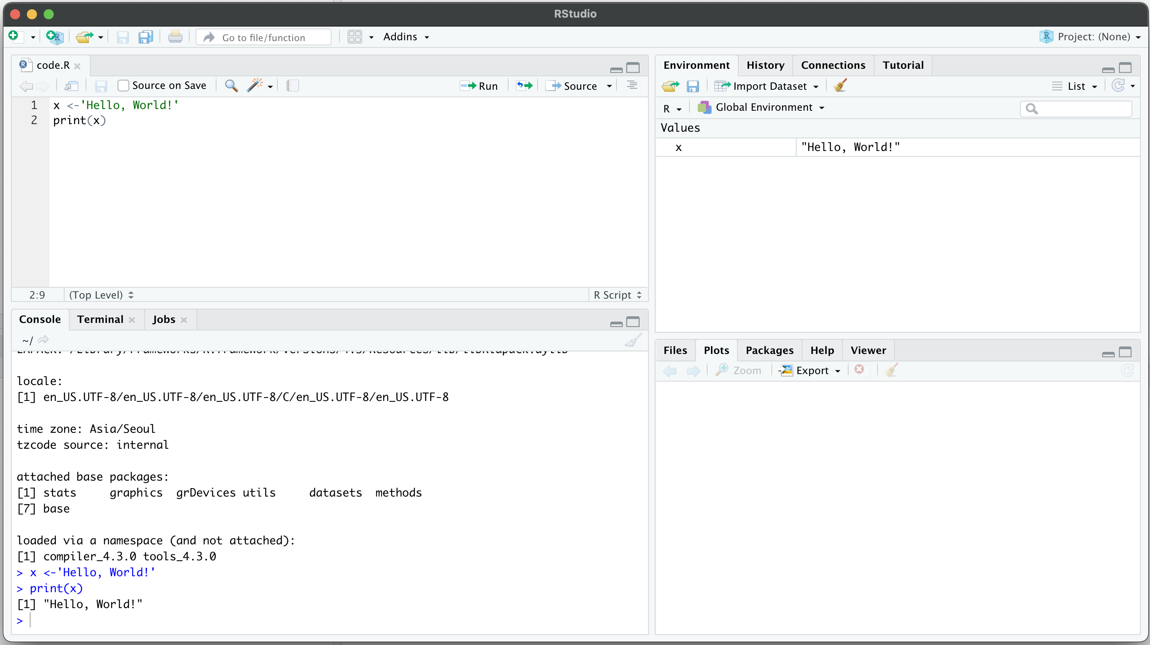
Rstudio
Rstudio – Integrated development environment (IDE) for R and python
Code editor
Environment / History
R console
Other panes
(Files, Plots, Packages, Help)
Code editor에서 코드를 작성하거나 적혀져 있는 코드를 실행합니다.
Ctrl+Enter를 통해 각 한 줄씩의 코드를 실행할 수 있습니다.

Slide 8
2. Then why python?

Slide 9



Python provides analysis tools that R does not
Some analysis tools are solely based on python
Here we will use squidpy for neighborhood enrichment analysis,
which R does not provide, on chapter 6

Slide 10
3. What is single cell RNA-seq and spatial transcriptomics?

Slide 11
Single-cell transcriptomics
Examines the gene expression level of individual cells in a given population by simultaneously measuring the RNA concentration (conventionally only messenger RNA (mRNA)) of hundreds to thousands of genes.
https://www.10xgenomics.com/single-cell-technology
Spatial transcriptomics
Since Visium Spatial Gene Expression is a spatial transcriptomics solution, you can analyze the transcriptome within the tissue context.
Visium Spatial Gene Expression works with cell capture slides that contain four capture areas with 5,000 barcoded spots. These barcoded spots include capture oligonucleotides that bind to the RNA in the tissue.
https://www.10xgenomics.com/spatial-transcriptomics

Slide 12
4. What is Space Ranger

Slide 13
What is Space Ranger?
Space Ranger is a set of analysis pipelines for processing 10X Genomics Visium sequence data (FASTQ files) with high resolution microscope images of tissue.
It maps the transcriptomic reads to the microscope image of the tissue
We will introduce spaceranger count pipeline

Slide 14
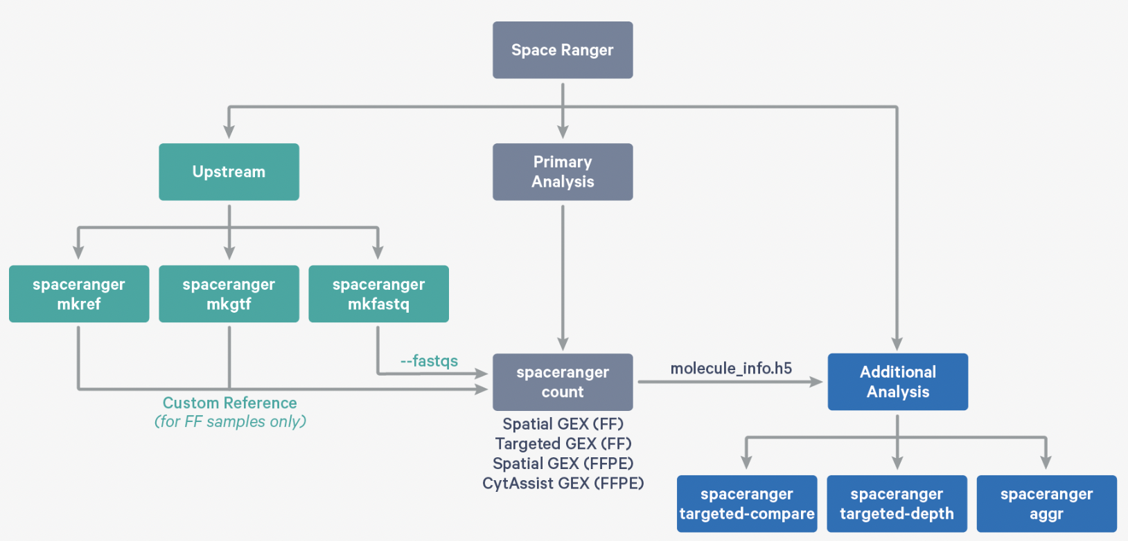
Space Ranger Pipelines
spaceranger mkfastq
spaceranger count
spaceranger aggr
spaceranger targeted-compare
spaceranger targeted-depth
https://support.10xgenomics.com/spatial-gene-expression/software/pipelines/latest/what-is-space-ranger

Slide 15
Installing Space Ranger
1. Download and unpack the Space Ranger .tar.gz file in any location
# Terminal
$cd /opt
$tar -xzvf spaceranger-2.0.0.tar.gz
2. Download and unpack proper reference data .tar.gz file in a convenient
location
$tar -xzvf refdata-gex-GRCh38-2020-A.tar.gz
3. Pre-pend the Space Ranger directory to your $PATH
$export PATH=/opt/spaceranger-2.0.0:$PATH
https://support.10xgenomics.com/spatial-gene-expression/software/pipelines/latest/installation

Slide 16
Run spaceranger count command
# Terminal
$cd /home/jdoe/runs
$spaceranger count --id=sample345 \ #Output directory
--transcriptome=/home/jdoe/refdata/GRCh38-2020-A \ #Path to Reference
--fastqs=/home/jdoe/runs/HAWT7ADXX/outs/fastq_path \ #Path to FASTQs
--sample=mysample \ #Sample name from FASTQ filename
--image=/home/jdoe/runs/images/sample345.tiff \ #Path to brightfield image
--slide=V19J01-123 \ #Slide ID
--area=A1 \ #Capture area
--localcores=8 \ #Allowed cores in localmode
--localmem=64 #Allowed memory (GB) in localmode
https://support.10xgenomics.com/spatial-gene-expression/software/pipelines/latest/using/count
Input : the microscope image (.tiff), FASTQ files(Fastq)
Perform : sequence alignment, tissue detection
Output : gene-spot matrix

Slide 17
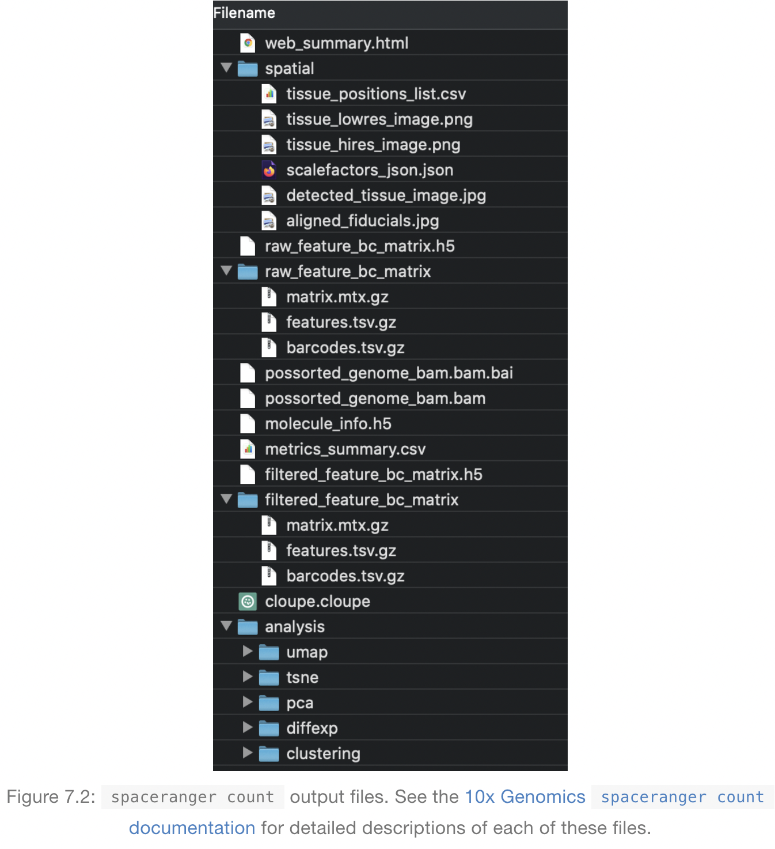
Output files of Space Ranger
https://lmweber.org/OSTA-book/space-ranger-visium.html
read10XVisium
Input files

Slide 18
Output files
raw_feature_bc_matrix
Dataset having spots that theoretically don’t overlap with tissue
filtered_feature_bc_matrix
Dataset filtered to the spots overlapping tissue, as determined by Loupe Browser
(Visium) alignment file
tissue_positions_list.csv
The spot coordinates information is stored
scalefactors_json.json
Scaling factors that convert spot coordinates to pixel coordinates
metrics_summary.csv
Metrics displayed in the interactive website
web_summary.html
Interactive website

Slide 19
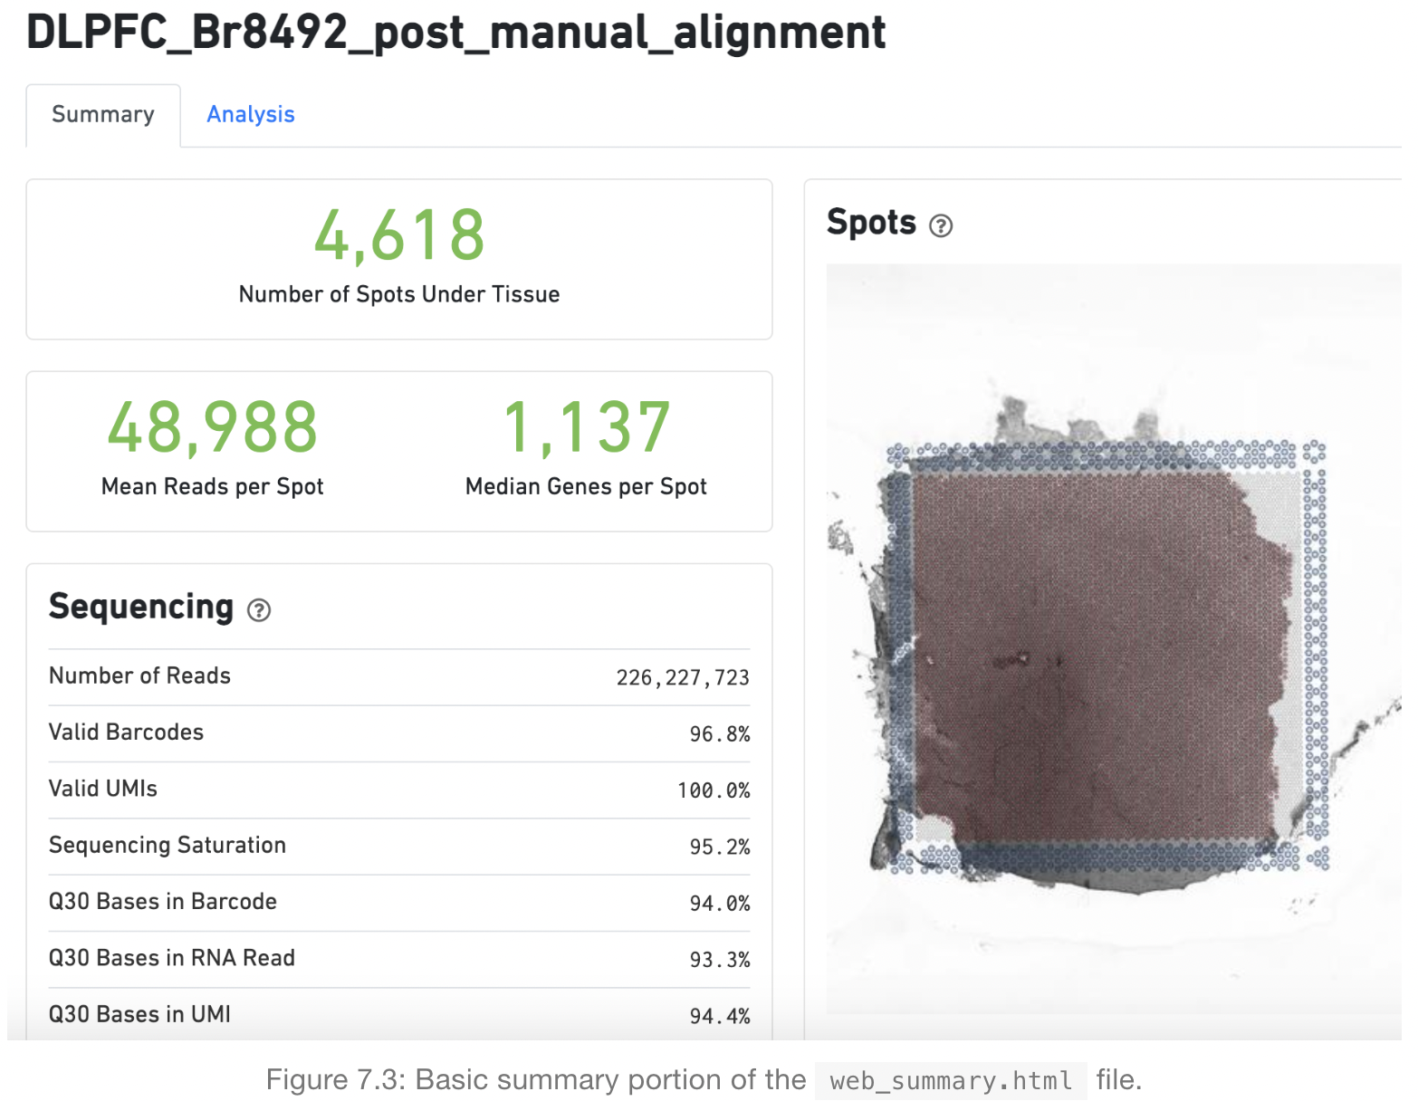
Web summary .html file
https://lmweber.org/OSTA-book/space-ranger-visium.html

Slide 20
Web summary .html file
Metrics | Definition | Expected/Recommended value
Number of Spots Under Tissue | The number of barcodes associated with a spot under tissue.
Mean Reads per Spot | The number of reads, both under and outside of tissue, divided by the number of barcodes associated with a spot under tissue. | Recommended: 50,000
Median Genes per Spot | The number of reads under tissue divided by the number of barcodes associated with a spot under tissue. | Vary by sample, and low values are not necessarily indicative of a failed experiment
Number of reads | Total number of read pairs that were assigned to this library in demultiplexing. | Fresh frozen libraries: a minimum of 50k FFPE v1 libraries: a minimum of 25k
Valid Barcodes | Fraction of reads with barcodes that match the whitelist* after barcode correction | Expected >75%
Valid UMIs | Fraction of reads with valid UMIs | Expected >75%
Sequencing Saturation | The fraction of reads originating from an already-observed UMI | Dependent upon sequencing depth and sample complexity (at last 60-80 % in most applications)
Q30 bases in barcode, Sample Index, or UMI | Fraction of tissue-associated barcode, Sample Index, or UMI bases with Q-Score >= 30, excluding very low quality/no call (Q≤2) bases from the denominator | Sequencing platform dependent (Most Illumina runs generate >70-80% Q30 data)
https://lmweber.org/OSTA-book/space-ranger-visium.html

Slide 21
What is a Loupe Browser?
Loupe Browser is a desktop application from 10x Genomics that allows to visualize gene expression data without having to write code
Align gene expression spots to histological images, look for marker gene expression, annotate populations, and cluster
The .cloupe file is the one that need to import into the Loupe Browser
Generally, 1~2 GB each

Slide 22
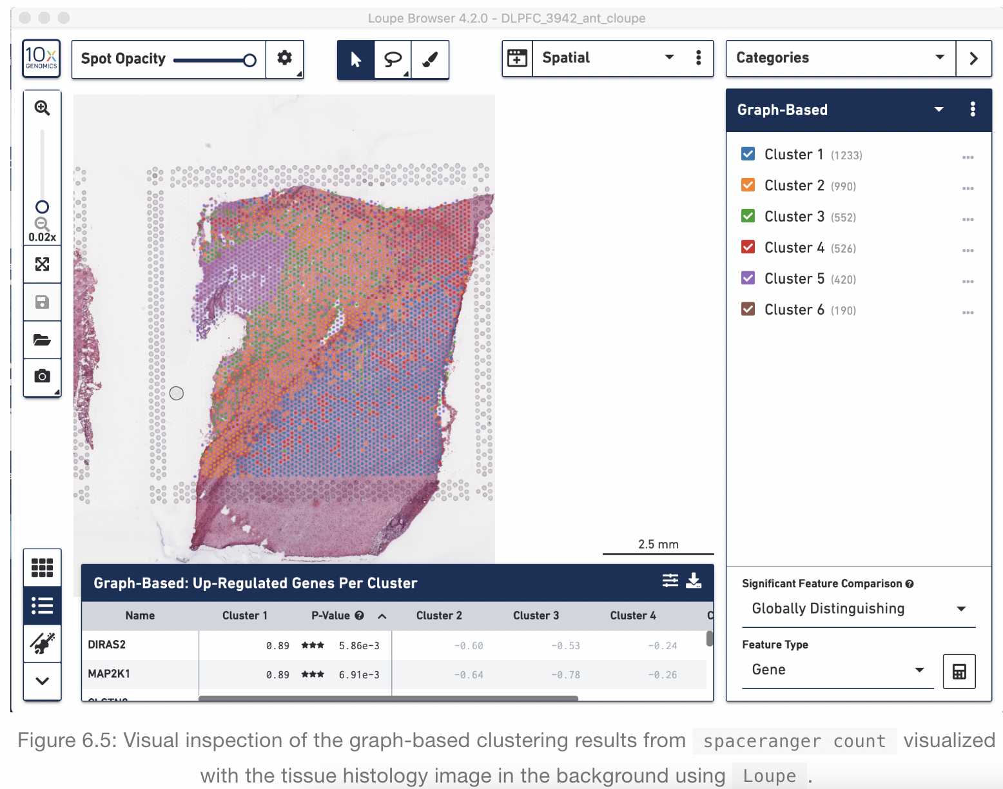
Loupe Browser
Histology image &
UMAP & t-SNE
Manual Annotation of spots
https://support.10xgenomics.com/spatial-gene-expression/software/visualization/latest/analysis

Slide 23
Download R packages to be used in analysis
install.packages("ggplot2")
install.packages("devtools")
install.packages("remotes")
install.packages("dplyr")
install.packages("anndata")
install.packages("cowplot")
install.packages('Seurat')
devtools::install_github('satijalab/seurat-data')
devtools::install_github("thomasp85/patchwork")
devtools::install_github("dmcable/spacexr", build_vignettes = FALSE)
remotes::install_github("jbergenstrahle/STUtility")
remotes::install_github("sqjin/CellChat")
Load packages
library(ggplot2)
library(devtools)
library(remotes)
library(dplyr)
library(anndata)
library(cowplot)
library(Seurat)
library(SeuratData)
library(patchwork)
library(spacexr)
library(STUtility)
library(cellchat)
# For reproducibility set the seed
set.seed(1234)

Slide 24
5. Integrative analysis of
spatial datasets - Seurat

Slide 25
Dataset Description
We will be using a recently released dataset of sagital mouse brain slices generated using the Visium v1 chemistry.
There are two serial anterior sections, and two (matched) serial posterior sections.
Biological annotations of spots (i.e., cell group information) are predicted using Seurat (https://satijalab.org/seurat/articles/spatial_vignette.html).

Slide 26
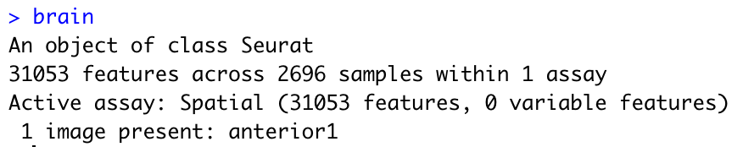
Load and preprocessing Visium
Load and preprocessing single cell
Find TransferAnchors
Transfer annotation
Load Brain data
# You need to specify exact directory
setwd("biml_2023")
# We can easily download the data with functions below
options(timeout=600)
InstallData("stxBrain")
brain <- LoadData("stxBrain", type = "anterior1")
Same with
brain = LoadData("stxBrain", type = "anterior1")
Explore Seurat object
brain

Slide 27
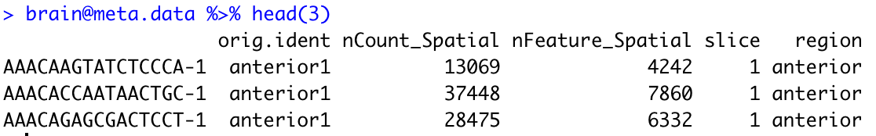
Load and preprocessing Visium
Load and preprocessing single cell
Find TransferAnchors
Transfer annotation
Explore metadata
brain@meta.data %>% head(3)
metadata | explanation
nCount_Spatial | the total number of detected molecules in each sample
nFeature_Spatial | the number of unique genes in each sample
slice | name of the stored image

Slide 28
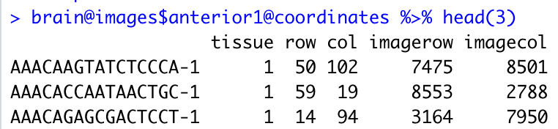
Explore coordinates
Load and preprocessing Visium
Load and preprocessing single cell
Find TransferAnchors
Transfer annotation
brain@images$anterior1@coordinates %>% head(3)
metadata | explanation
tissue | Binary, indicating if the spot falls inside (1) or outside (0) of tissue
row | The row coordinate of the spot in the array from 0 to 77
col | The column coordinate of the spot in the array
imagerow | The row pixel coordinate of the center of the spot in the full resolution image.
imagecol | The column pixel coordinate of the center of the spot in the full resolution image.

Slide 29
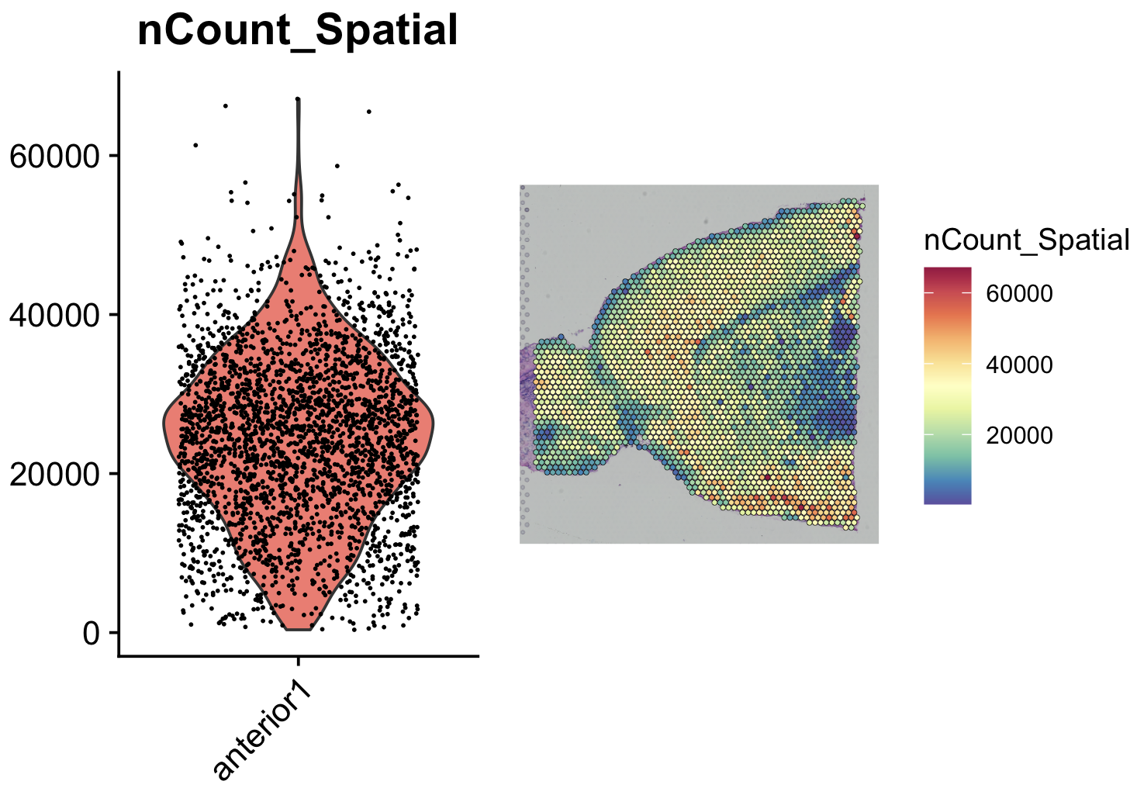
Load Brain data
Load and preprocessing Visium
Load and preprocessing single cell
Find TransferAnchors
Transfer annotation
# nCount_Spatial: the total number of detected molecules in each sample
plot1 = VlnPlot(brain, features = "nCount_Spatial", pt.size = 0.1) + NoLegend()
plot2 = SpatialFeaturePlot(brain, features = "nCount_Spatial") + theme(legend.position = "right")
# wrap_plots: take a list of plots and add them into one composition
wrap_plots(plot1, plot2)

Slide 30
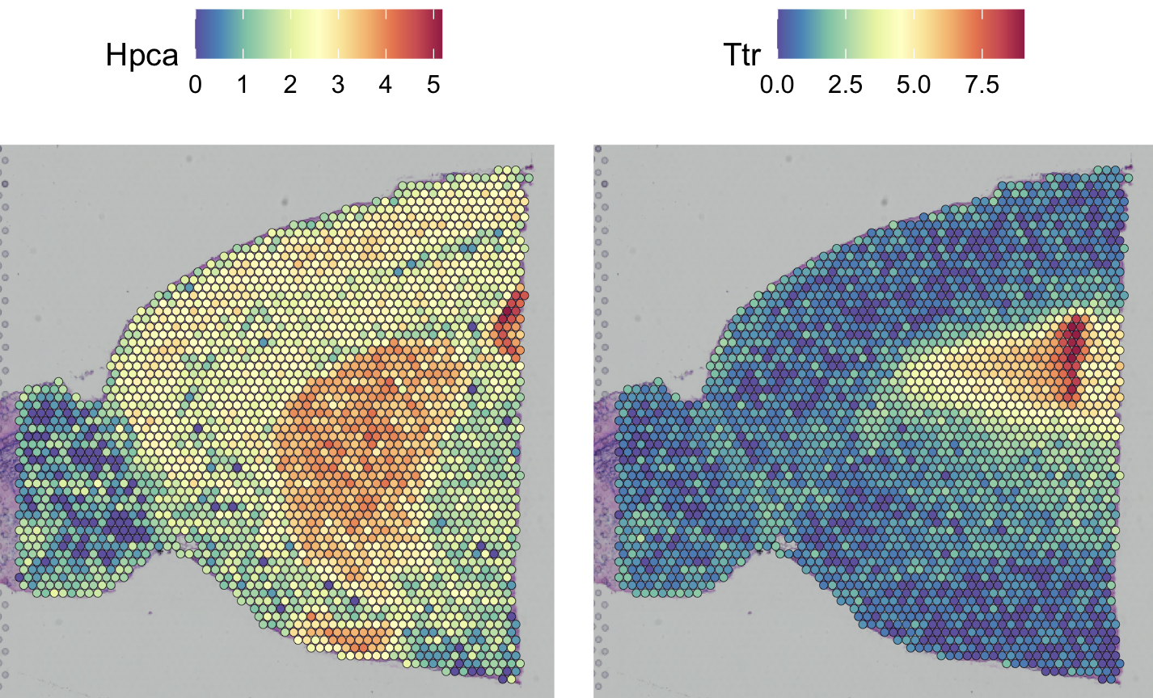
Pre-processing: SCT normalize
Load and preprocessing Visium
Load and preprocessing single cell
Find TransferAnchors
Transfer annotation
# SCTransform calculates a model of technical noise using 'regularized negative binomial regression’.
This replaces NormalizeData, ScaleData, and FindVariableFeatures.
brain = SCTransform(brain, assay = "Spatial", verbose = FALSE)
Visualization of gene expression
SpatialFeaturePlot(brain, features = c("Hpca", "Ttr"))

Slide 31
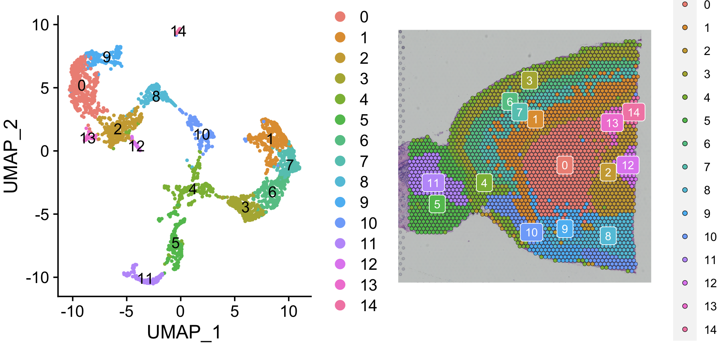
Dimension reduction and clustering
Load and preprocessing Visium
Load and preprocessing single cell
Find TransferAnchors
Transfer annotation
# PCA dimensionality reduction
brain = RunPCA(brain, assay = "SCT", verbose = FALSE)
# Compute an SNN (Shared Nearest-neighbor) on the gene expression level
brain = FindNeighbors(brain, reduction = "pca", dims = 1:30)
brain = FindClusters(brain, verbose = FALSE)
brain = RunUMAP(brain, reduction = "pca", dims = 1:30)
Visualization of each cluster
p1 = DimPlot(brain, reduction = "umap", label = TRUE)
p2 = SpatialDimPlot(brain, label = TRUE, label.size = 3)
p1 + p2

Slide 32
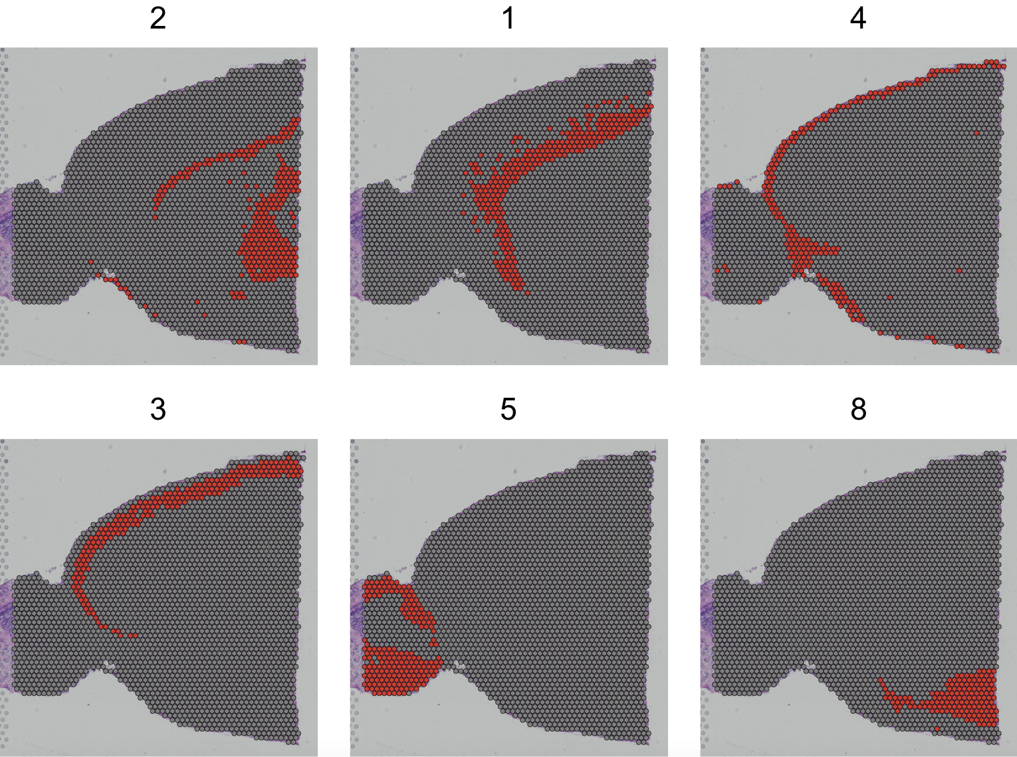
Spatial Dimplot of some cluster
Load and preprocessing Visium
Load and preprocessing single cell
Find TransferAnchors
Transfer annotation
# facet.highlight: split each group into its own plot
SpatialDimPlot(brain, cells.highlight = CellsByIdentities(object = brain, idents = c(2, 1, 4, 3, 5, 8)), facet.highlight = TRUE, ncol = 3)

Slide 33
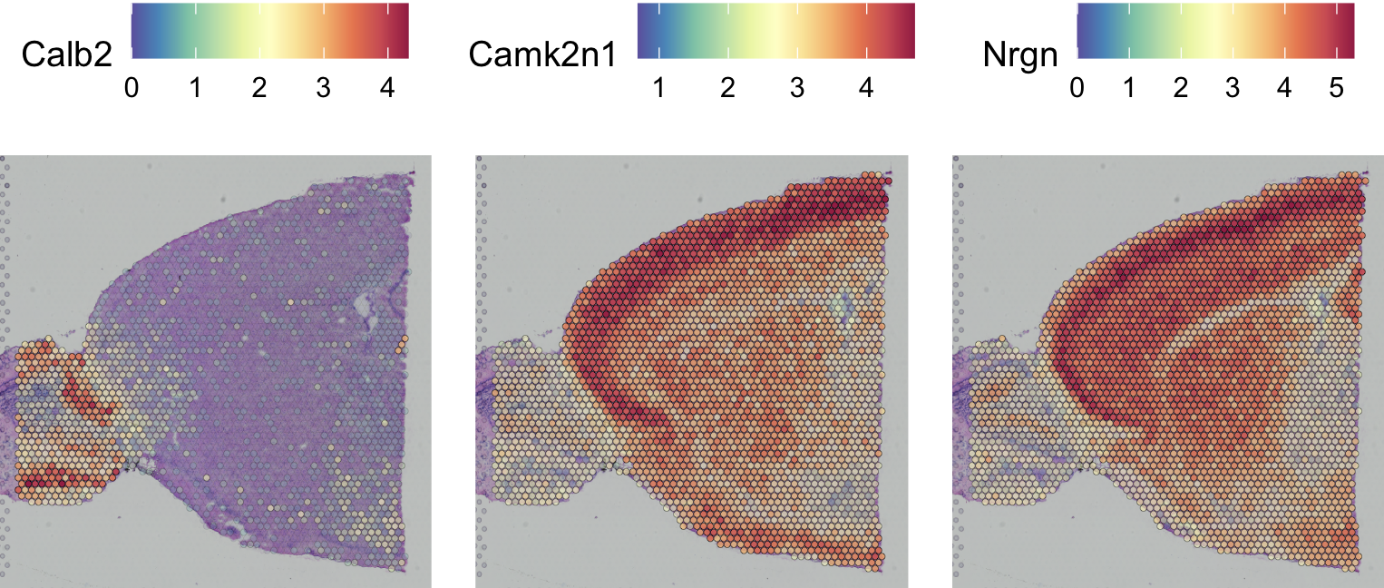
Identification of spatially variable features
Load and preprocessing Visium
Load and preprocessing single cell
Find TransferAnchors
Transfer annotation
# We can find cluster 5 markers compared to cluster 6
de_markers = FindMarkers(brain, ident.1 = 5, ident.2 = 6)
SpatialFeaturePlot(object = brain, features = rownames(de_markers)[1:3], alpha = c(0.1, 1), ncol = 3)
saveRDS(brain, "./BIML_visium_brain_processed.rds")

Slide 34
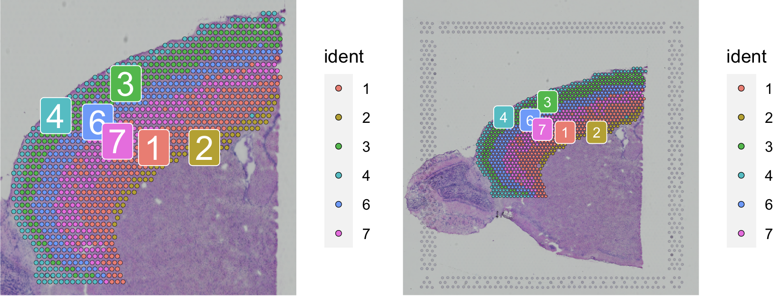
Load and preprocessing Visium
Load and preprocessing single cell
Find TransferAnchors
Transfer annotation
Subset out anatomical regions
cortex = subset(brain, idents = c(1, 2, 3, 4, 6, 7))
cortex = subset(cortex, anterior1_imagerow > 400 | anterior1_imagecol < 150, invert = TRUE)
cortex = subset(cortex, anterior1_imagerow > 275 & anterior1_imagecol > 370, invert = TRUE)
cortex = subset(cortex, anterior1_imagerow > 250 & anterior1_imagecol > 440, invert = TRUE)
p1 = SpatialDimPlot(cortex, crop = TRUE, label = TRUE)
p2 = SpatialDimPlot(cortex, crop = FALSE, label = TRUE, pt.size.factor = 1, label.size = 3)
# We merge two plots
p1 + p2
cortex = SCTransform(cortex, assay = "Spatial", verbose = FALSE) %>% RunPCA(verbose = FALSE)
saveRDS(cortex, "./BIML_visium_cortex_processed.rds")
34

Slide 35
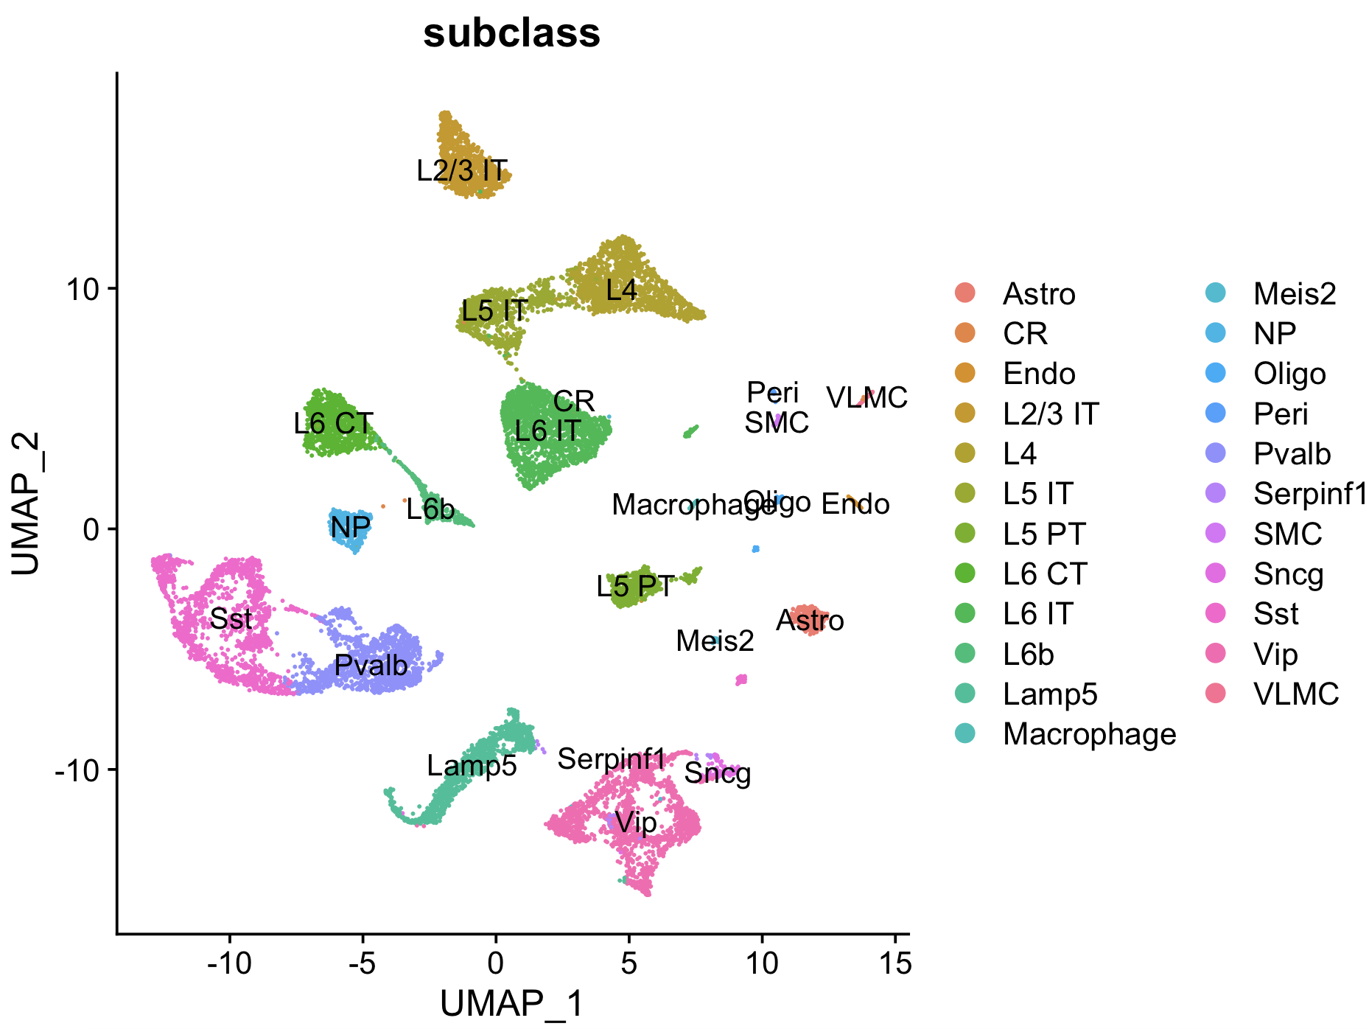
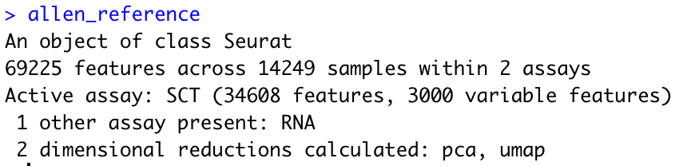
Load reference single cell data
Load and preprocessing VIsium
Load and preprocessing single cell
Find TransferAnchors
Transfer annotation
allen_reference = readRDS("./BIML_sc_allen_cortex.rds")
allen_reference = SCTransform(allen_reference, ncells = 3000, verbose = FALSE) %>% RunPCA(verbose = FALSE) %>% RunUMAP(dims = 1:30)
allen_reference
DimPlot(allen_reference, group.by = "subclass", label = TRUE)

Slide 36
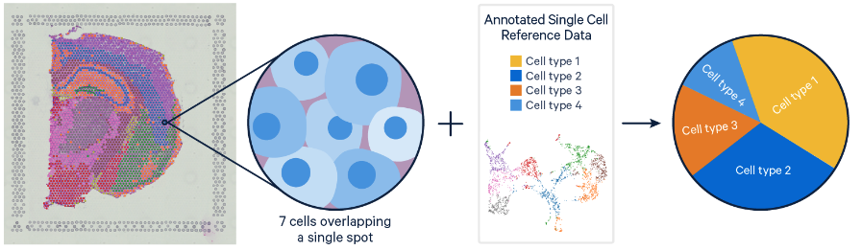
Integrate single cell and visium spatial gene expression data
Load and preprocessing VIsium
Load and preprocessing single cell
Find TransferAnchors
Transfer annotation
Elucidate spatiality in single cell data and improve resolution in Visium data
Problem
Single Cell RNAseq methods resolve gene expression at the single cell level, but lose the spatial context.
Visium spatial gene expression maintains spatial information, but the resolution of each spot is limited (1-10 cells).
Solution
- Deconvolution (Identify the cell types and their relative proportions contributing to a spot)
- Mapping (Assign the most likely dominant cell type to a spot)
https://www.10xgenomics.com/resources/analysis-guides/integrating-single-cell-and-visium-spatial-gene-expression-data

Slide 37
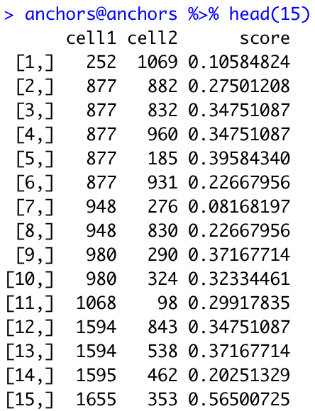
Find TransferAnchors
Load and preprocessing VIsium
Load and preprocessing single cell
Find TransferAnchors
Transfer annotation
# Find a set of anchors between a reference and query object. These anchors can later be used to
transfer data from the reference to query object using the TransferData object.
anchors = FindTransferAnchors(reference = allen_reference, query = cortex, normalization.method = "SCT")
anchors@anchors %>% head(15)

Slide 38
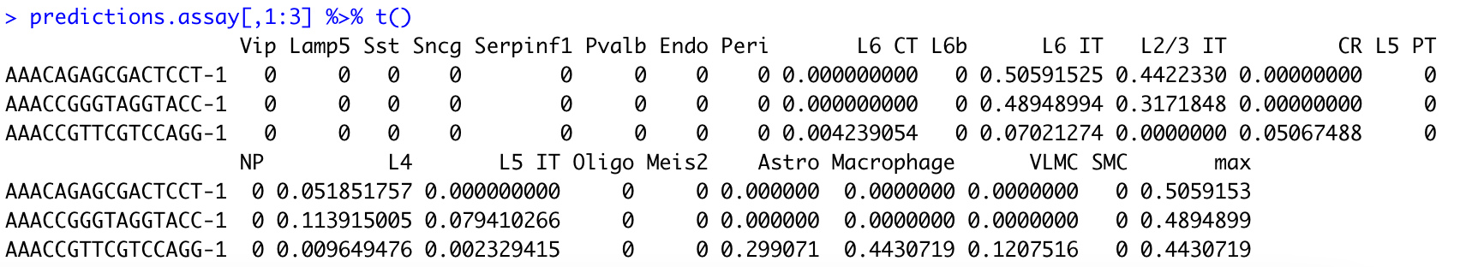
Acquire prediction assay
Load and preprocessing VIsium
Load and preprocessing single cell
Find TransferAnchors
Transfer annotation
# TransferData: Transfer categorical or continuous data across single-cell datasets
# weight.reduction: Dimensional reduction to use for the weighting anchors
predictions.assay = TransferData(anchorset = anchors, refdata = allen_reference$subclass, prediction.assay = TRUE, weight.reduction = cortex[["pca"]], dims = 1:30)
predictions.assay[,1:3] %>% t()

Slide 39
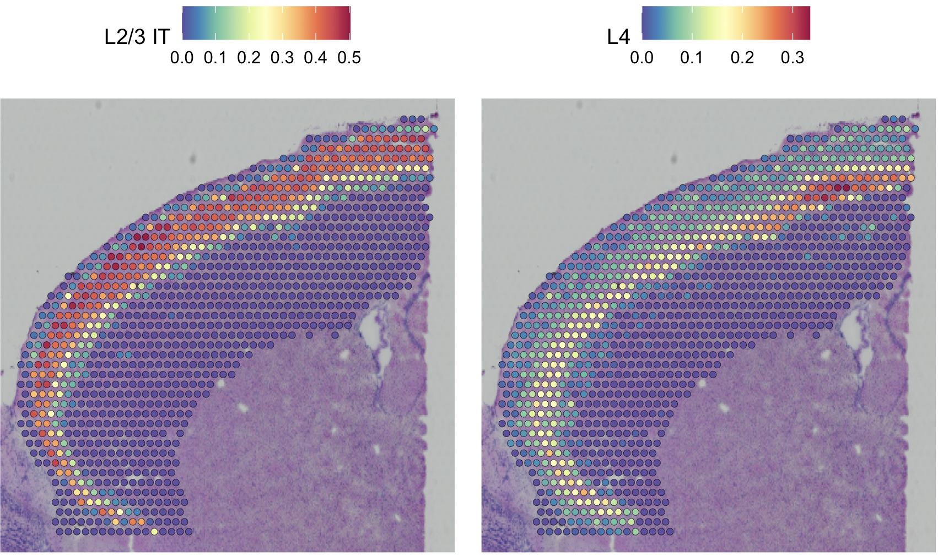
Insert the prediction assay into the cortex object
Load and preprocessing VIsium
Load and preprocessing single cell
Find TransferAnchors
Transfer annotation
# Created prediction assay
cortex[["predictions"]] = predictions.assay
DefaultAssay(cortex) = "predictions”
SpatialFeaturePlot(cortex, features = c("L2/3 IT", "L4"), pt.size.factor = 1.6, ncol = 2, crop = TRUE)

Slide 40
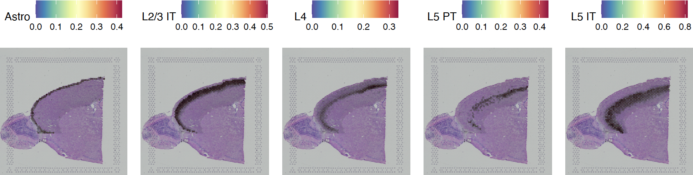
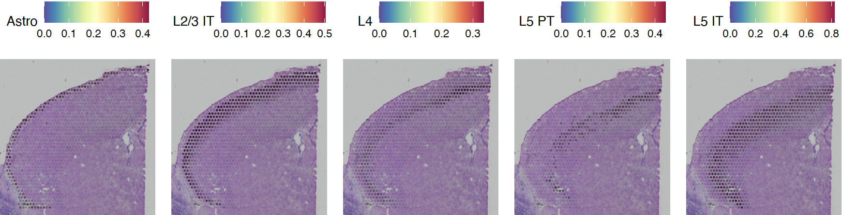
Spatial Feature Plot of predicted cell type proportion
Load and preprocessing VIsium
Load and preprocessing single cell
Find TransferAnchors
Transfer annotation
pdf('./integreated_spatialfeautrePlot.pdf', width = 10, height = 5)
SpatialFeaturePlot(cortex, features = c("Astro", "L2/3 IT", "L4", "L5 PT", "L5 IT"), pt.size.factor = 1, ncol = 5, crop = FALSE, alpha = c(0.1, 1))
SpatialFeaturePlot(cortex, features = c("Astro", "L2/3 IT", "L4", "L5 PT", "L5 IT"), pt.size.factor = 1, ncol = 5, crop = T, alpha = c(0.1, 1))
dev.off()

Slide 41
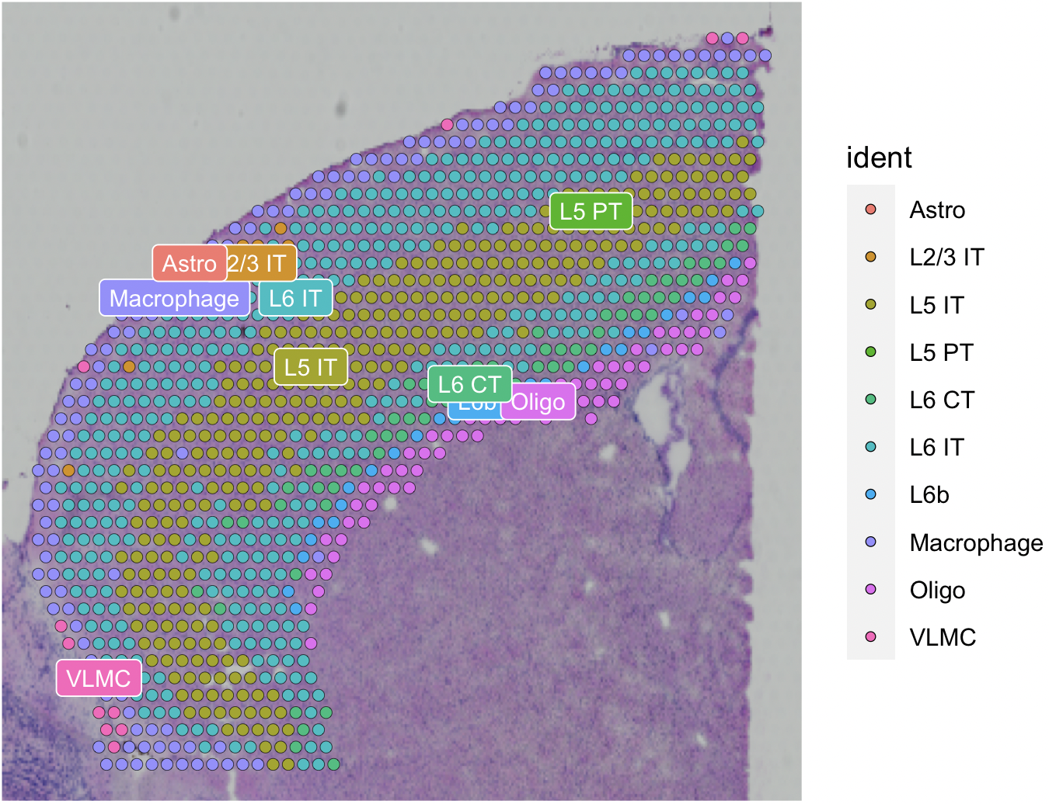
Transfer annotation
Load and preprocessing VIsium
Load and preprocessing single cell
Find TransferAnchors
Transfer annotation
# We also get predicted cell type metadata for each spot
predictions = TransferData(anchorset = anchors, refdata = allen_reference$subclass,weight.reduction = cortex[["pca"]], dims = 1:30)
cortex = AddMetaData(cortex, metadata = predictions)
cortex$predicted.id <- factor(cortex$predicted.id)
cortex <- SetIdent(cortex, value="predicted.id")
SpatialDimPlot(cortex, label = T, label.size = 3)

Slide 42
Remove all objects before starting next chapter
rm(allen_reference)
rm(brain)
rm(cortex)
rm(anchors)
rm(predictions);
rm(predictions.assay);
gc()

Slide 43
6. Deconvolution Analysis
- SpaceXR

Slide 44
RCTD Algorithm
Process single cell for RCTD input
Process spatial for RCTD input
Run RCTD
Process output for deconvolution
RCTD(Robust cell type decomposition)
Method that decomposes cell type mixtures using cell type profiles learned from single-cell RNA-seq
Computes the average gene expression profile for each cell type using scRNA-seq data
By fitting each spatial transcriptomics spot as a linear combination of individual cell types, RCTD generates a spatial map of cell types
The gene expression of each cell type for a given spot is estimated by fitting a statistical model to observed gene counts (Assume to follow poisson distributions)
This model is also optimized with maximum-likelihood estimation (MLE)
Robust decomposition of cell type mixtures in spatial transcriptomics

Slide 45
Load RCTD input reference dataset (single cell)
Process single cell for RCTD input
Process spatial for RCTD input
Run RCTD
Process output for deconvolution
allen_reference = readRDS("./BIML_sc_allen_cortex.rds")
allen_reference = subset(allen_reference, subclass != c("CR"))
Excluded CR cell type since since it needs a minimum of 25 cells for each cell type in the reference

Slide 46
Prepare single cell dataset for RCTD input
Process single cell for RCTD input
Process spatial for RCTD input
Run RCTD
Process output for deconvolution
allen_counts = allen_reference$RNA@counts
allen_meta_data = allen_reference@meta.data
# Renamed the cluster due to prohibited characters “/”
allen_reference = SetIdent(allen_reference, value="subclass")
allen_reference = RenameIdents(allen_reference, "L2/3 IT" = "L2_3 IT")
allen_reference$subclass = allen_reference@active.ident
allen_annotation = allen_reference@meta.data$subclass
names(allen_annotation) = rownames(allen_meta_data)
allen_annotation = as.factor(allen_annotation)
allen_nUMI = allen_meta_data$nCount_RNA
names(allen_nUMI) = rownames(allen_meta_data)
allen_reference = Reference(allen_counts, allen_annotation, allen_nUMI)

Slide 47
Process spatial dataset for RCTD input
Process single cell for RCTD input
Process spatial for RCTD input
Run RCTD
Process output for deconvolution
brain = readRDS("./BIML_visium_brain_processed.rds")
spatial_counts_brain = brain@assays$Spatial@counts
spatial_nUMI_brain = colSums(spatial_counts_brain)
coords_brain = brain@images$anterior1@coordinates[,c("col","row")]
nUMI_brain = colSums(spatial_counts_brain)
puck_brain = SpatialRNA(coords_brain, spatial_counts_brain, spatial_nUMI_brain)

Slide 48
Process single cell for RCTD input
Process spatial for RCTD input
Run RCTD
Process output for deconvolution
Running RCTD (Full mode, Doublet mode)
# Doublet mode: Fits at most two cell types per pixel. Classifies each pixel as 'singlet' or 'doublet' and searches for the cell
types on the pixel.
# Full mode: Fit any number of cell types on each pixel
# Each process takes 30 min ~ 1 hour
RCTD_brain = create.RCTD(puck_brain, allen_reference, max_cores = 8)
RCTD_brain = run.RCTD(RCTD_brain, doublet_mode = 'full’)
RCTD_brain_doublet = run.RCTD(RCTD_brain, doublet_mode = 'doublet')
Save RCTD results file
# We need to normalize the decomposed matrix
RCTD_results = sweep(RCTD_brain@results$weights, 1,
rowSums(RCTD_brain@results$weights), '/’)
write.csv(RCTD_results, "./BIML_spacexr_cortex_fullmode.csv")
write.csv(RCTD_brain_doublet@results$results_df,"./BIML_spacexr_cortex_doubletmode.csv")

Slide 49
Processs RCTD decomposed file (full mode)
Process single cell for RCTD input
Process spatial for RCTD input
Run RCTD
Process output for deconvolution
full_rctd = read.csv("./BIML_spacexr_cortex_fullmode.csv", header = TRUE, row.names = 1)
colnames(full_rctd) = gsub("weights.","",colnames(full_rctd))
brain[['RCTD']] = CreateAssayObject(counts = t(as.matrix(full_rctd)))
DefaultAssay(brain) = "RCTD"
Processs RCTD decomposed file (doublet mode)
doublet_rctd <- read.table("./BIML_spacexr_cortex_doubletmode.csv", sep=",", header=TRUE)
spacexr_metadata <- doublet_rctd[,c("X", "first_type")]
colnames(spacexr_metadata) <- c("barcodes", "spacexr_first_type")
rownames(spacexr_metadata) <- spacexr_metadata$barcodes; spacexr_metadata$barcodes <- NULL
brain <- AddMetaData(brain, spacexr_metadata)
brain <- SetIdent(brain, value="spacexr_first_type")

Slide 50
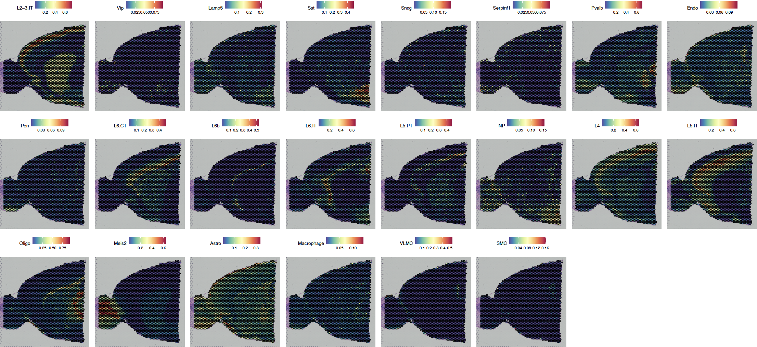
Spatial map of predicted cell type proportions by RCTD
Process single cell for RCTD input
Process spatial for RCTD input
Run RCTD
Process output for deconvolution
pdf("./RCTD_decomposed_Spatial_Featureplot.pdf", height=15, width=25)
SpatialFeaturePlot(brain, features =rownames(brain),ncol=8, pt.size.factor = 1.6, crop = TRUE)
dev.off()

Slide 51
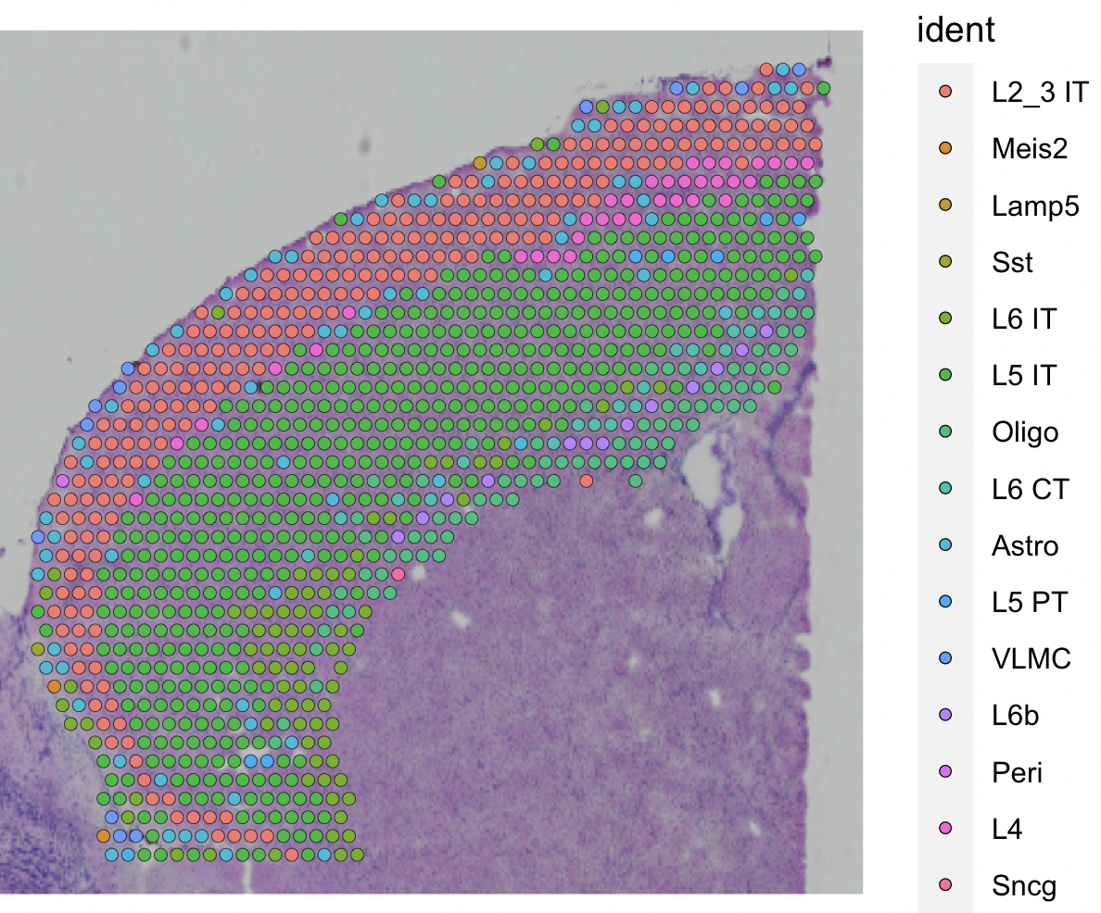
Process single cell for RCTD input
Process spatial for RCTD input
Run RCTD
Process output for deconvolution
Spatial map of predicted cell type proportions by RCTD
cortex = subset(brain, seurat_clusters %in% c(1, 2, 3, 4, 6, 7))
cortex = subset(cortex, anterior1_imagerow > 400 | anterior1_imagecol < 150, invert = TRUE)
cortex = subset(cortex, anterior1_imagerow > 275 & anterior1_imagecol > 370, invert = TRUE)
cortex = subset(cortex, anterior1_imagerow > 250 & anterior1_imagecol > 440, invert = TRUE)
SpatialDimPlot(cortex)
# This file will be used in the Squidpy and CellChat Analysis
saveRDS(cortex, "./BMIL_visium_cortex_annotated.rds")

Slide 52
Remove all objects before starting next chapter
rm(brain)
rm(spatial_counts_brain)
rm(spatial_nUMI_brain)
rm(coords_brain)
rm(nUMI_brain)
rm(puck_brain)
rm(barcodes_brain)
rm(RCTD_brain)
rm(RCTD_brain_doublet)
rm(RCTD_results)
rm(full_rctd)
rm(doublet_rctd)
rm(spacexr_metadata)
rm(cortex)
gc()

Slide 53
7. Neighborhood Analysis
of Co-occurrence - Squidpy

Slide 54
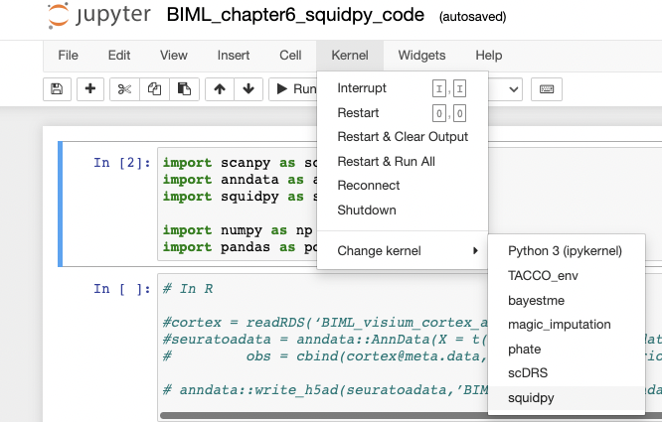
Install Squidpy via conda
Install squidpy
Convert /Load data
Neighborhood enrichment analysis
Co-occurrence analysis
We assume that conda is already installed on your laptop/computer
Instruction below starts from installing jupyter notebook. If you have equivalent platform for visualizing result plots, just follow black parts
Open your terminal and move to the directory ‘biml_2023’ where we downloaded all files for the exercise
Type conda env create -f environment.yml to create conda environment named squidpy
Type python –m pip install –upgrade pip
Type python -m pip install jupyter
Type conda activate squidpy
Type conda install -c anaconda ipykernel
Type python -m ipykernel install --user --name=squidpy
Type conda deactivate squidpy
Type jupyter notebook
Change kernel to squidpy like the image

Slide 55
Convert data from Seurat object to Anndata
Install squidpy
Convert /Load data
Neighborhood enrichment analysis
Co-occurrence analysis
In R
cortex = readRDS(‘BMIL_visium_cortex_annotated.rds’)
seuratoadata = anndata::AnnData(X = t(cortex@assays$SCT@data),
obs = cbind(cortex@meta.data,cortex@images$anterior1@coordinates), dtype='float32’)
anndata::write_h5ad(seuratoadata,’BMIL_visium_cortex_anndata.h5ad’)

Slide 56
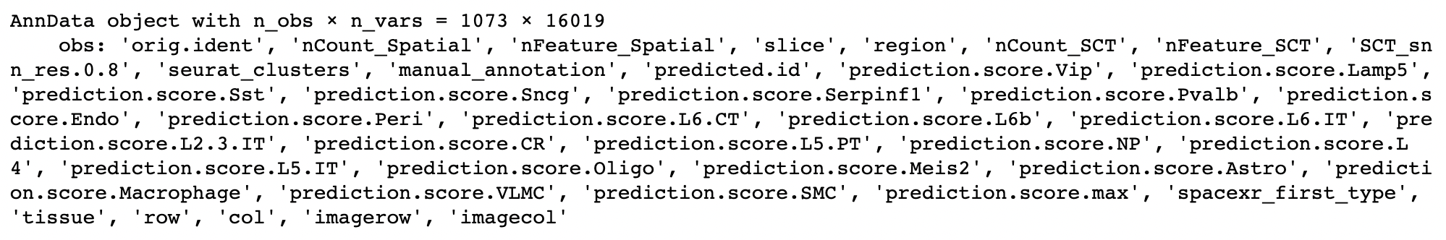
Load and expore how anndata looks like
Install squidpy
Convert /Load data
Neighborhood enrichment analysis
Co-occurrence analysis
In Python
import scanpy as sc
import anndata as ad
import squidpy as sq
import numpy as np
import pandas as pd adata = ad.read_h5ad(“BMIL_visium_cortex_anndata.h5ad”)
adata
n_obs: cell number
n_vars: gene number
obs: info of seurat@metadata

Slide 57
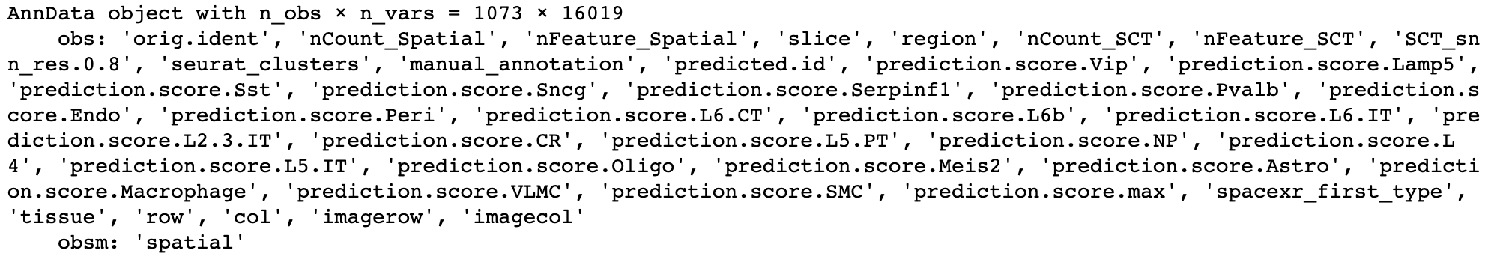
Save spatial information in adata.obsm
Install squidpy
Convert /Load data
Neighborhood enrichment analysis
Co-occurrence analysis
In Python
# make an array having spatial coordinates
spatial_info = adata.obs[['row', 'col']].values.tolist()
adata.obsm['spatial'] = np.array(spatial_info)
adata

Slide 58
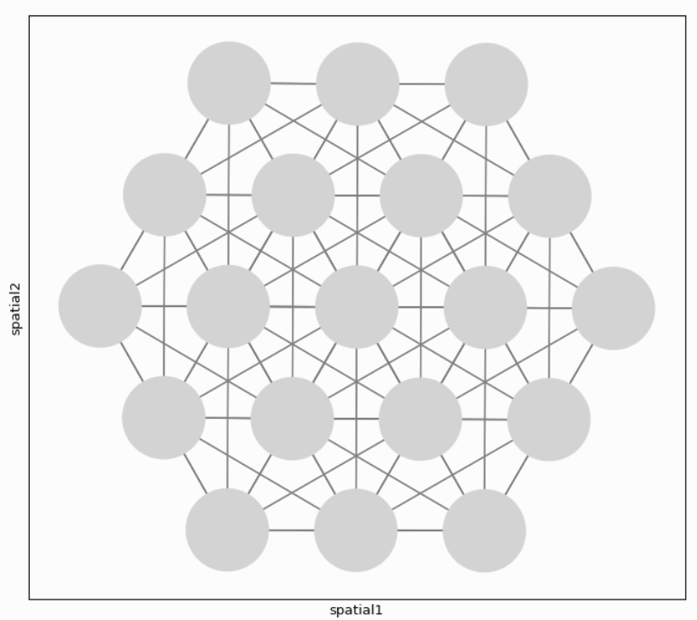
Builds a spatial graph
Install squidpy
Convert /Load data
Neighborhood enrichment analysis
Co-occurrence analysis
In Python
sq.gr.spatial_neighbors(adata)
# Adjacency matrix
adata.obsp["spatial_connectivities"]
# Weighted Adjacency matrix
adata.obsp["spatial_distances"]
Build spatial graph with
observations( = spots) as nodes and neighbor-hood relations between observations as edges.
To identify neighbors, spatial coordinates of spots are used.

Slide 59
Calculate enrichment score based on spatial graph
Install squidpy
Convert /Load data
Neighborhood enrichment analysis
Co-occurrence analysis
In Python
sq.gr.nhood_enrichment(adata, cluster_key=“spacexr_first_type”)
Enrichment score is calculated based on permutation-based test
involving spatial graph .
If spots belonging to two different clusters are often close to each other, then they will have a high score and can be defined as being enriched.

Slide 60
Visualize neighborhood enrichment and select the pair
Install squidpy
Convert /Load data
Neighborhood enrichment analysis
Co-occurrence analysis
In Python
sq.pl.nhood_enrichment(adata, cluster_key=“spacexr_first_type”)
Except for diagonal squares, Oligo – L6b pair has the high enrichment.
(red boxed)

Slide 61
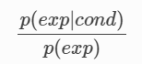
Calculate co-occrurence probability
Install squidpy
Convert /Load data
Neighborhood enrichment analysis
Co-occurrence analysis
In Python
sq.gr.co_occurrence(adata, cluster_key="spacexr_first_type")
Co-occurence also shows the closeness of two different clusters but without involving spatial graph. It is operated on the original spatial coordinates.
The co-occurrence score is defined as:
The score is computed across increasing radii size around each spots in the tissue.
p(exp|cond): conditional probability of observing a cluster exp conditioned on the presence of a cluster cond
p(exp): probability of observing exp in the radius size of interest.

Slide 62
Visualizing Co-occurrence of other cell types with Oligodendrocytes
Install squidpy
Convert /Load data
Neighborhood enrichment analysis
Co-occurrence analysis
In Python
# Set cond as Oligo by param ‘clusters’
sq.pl.co_occurrence(adata, cluster_key="spacexr_first_type",
clusters=”Oligo", figsize=(8*1.2, 4*1.2))
Visualizing the result of Co-occurrence score with Oligodendrocytes.
Similar to neighborhood enrichment result, though not the highest, Oligo shows high Co-occurrence score when the distance (=radii) is small.

Slide 63
7. Cell-cell interaction analysis
- Cellchat

Slide 64

What is CellChat?
CellChat is an useful tool to quantitatively infer and analyze intercellular communication networks from single-cell RNA-sequencing data and spatial transcriptomics data.
Requires gene expression and spatial location data of spots/cells as the user input and models the probability of cell-cell communication by integrating gene expression with spatial distance as well as prior knowledge of the interactions between signaling ligands, receptors and their cofactors.
JIN, Suoqin, et al. Inference and analysis of cell-cell communication using CellChat. Nature communications, 2021, 12.1: 1-20.
https://htmlpreview.github.io/?https://github.com/sqjin/CellChat/blob/master/tutorial/CellChat_analysis_of_spatial_imaging_data.html

Slide 65
Load data
Load dataset
Preprocessing
Inference of cell-cell communication network
Visualization network
# Load cell type annotated visium data and set levels for the downstream analysis.
visium.brain = readRDS('./BIML_visium_cortex_annotated.rds')
visium.brain$spacexr_first_type = factor(visium.brain$spacexr_first_type, levels=c("Astro", "L2_3 IT", "L4", "L5 IT", "L5 PT", "L6 CT", "L6 IT", "L6b", "Lamp5", "Meis2”, "Oligo", "Peri", "Sncg", "Sst", "VLMC"))
Idents(visium.brain) = visium.brain$spacexr_first_type
colors = scPalette(nlevels(visium.brain))
names(colors) = c("Astro", "L2_3 IT", "L4", "L5 IT", "L5 PT", "L6 CT", "L6 IT", "L6b", "Lamp5", "Meis2", "Oligo", "Peri", "Sncg", "Sst", "VLMC")

Slide 66
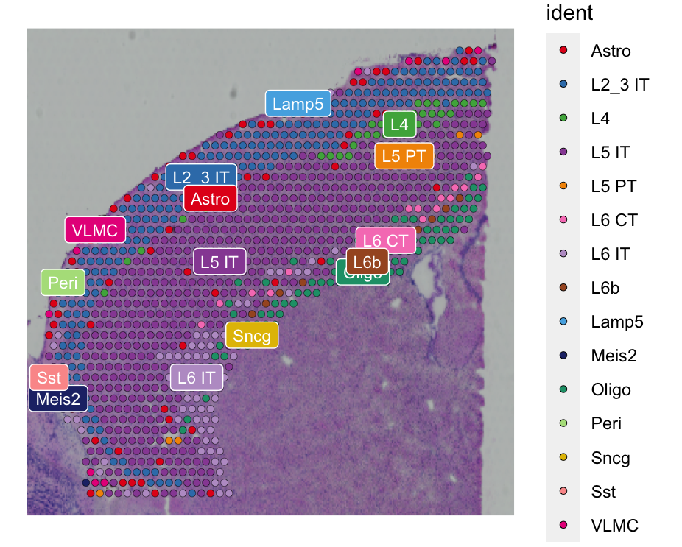
Visualization of our data
Load dataset
Preprocessing
Inference of cell-cell communication network
Visualization network
SpatialDimPlot(visium.brain, label = T, label.size = 3, cols = colors)
There are 15 cell types from our visium data.

Slide 67
Prepare input data for CellChat analysis
Load dataset
Preprocessing
Inference of cell-cell communication network
Visualization network
data.input = GetAssayData(visium.brain, slot = "data", assay = "SCT")
meta = data.frame(labels = Idents(visium.brain), row.names = names(Idents(visium.brain)))
# check the cell labels
unique(meta$labels)

Slide 68
Load spatial imaging information
Load dataset
Preprocessing
Inference of cell-cell communication network
Visualization network
# Load spatial imaging information to get the spot information.
spatial.locs = GetTissueCoordinates(visium.brain, scale = NULL, cols = c("imagerow", "imagecol"))
scale.factors = jsonlite::fromJSON(txt = "BIML_scalefactors_json.json")
scale.factors = list(spot.diameter=65, spot=scale.factors$spot_diameter_fullres, fiducial = scale.factors$fiducial_diameter_fullres, hires = scale.factors$tissue_hires_scalef, lowres = scale.factors$tissue_lowres_scalef)

Slide 69
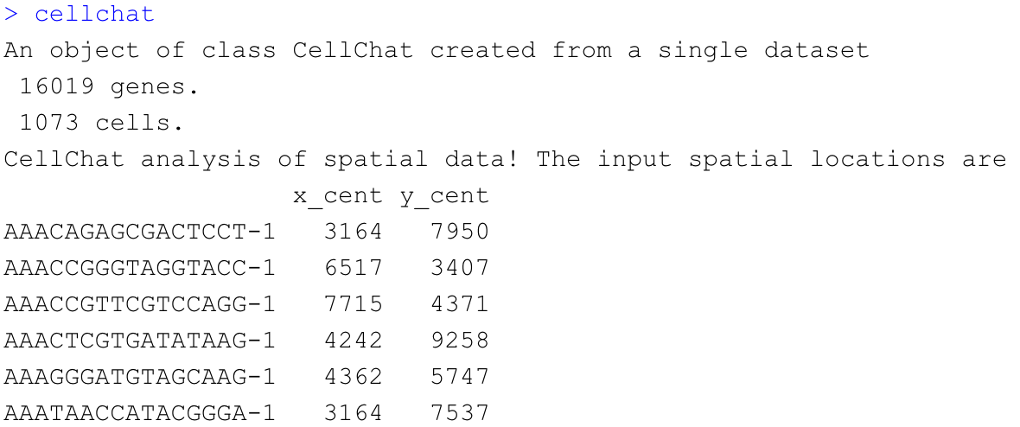
Create a CellChat object
Load dataset
Preprocessing
Inference of cell-cell communication network
Visualization network
# Create a CellChat object for the downstream analysis.
cellchat = createCellChat(object = data.input, meta = meta, group.by = "labels", datatype = "spatial", coordinates = spatial.locs, scale.factors = scale.factors)
cellchat

Slide 70
Set the ligand-receptor interaction database
Load dataset
Preprocessing
Inference of cell-cell communication network
Visualization network
CellChatDB = CellChatDB.mouse
cellchat@DB = CellChatDB
CellChatDB : Manually curated database of literature-supported ligand-receptor interactions in both human and mouse.
Since our toy data is a mouse brain 10x visium data, we load CellChatDB.mouse

Slide 71
Preprocess of the expression data for cell-cell communication analysis
Load dataset
Preprocessing
Inference of cell-cell communication network
Visualization network
# Subset the expression data of signaling genes for saving computation cost
cellchat = subsetData(cellchat)
# do parallel
future::plan("multiprocess", workers = 4)
# Identify over-expressed ligands or receptors in one cell group
cellchat = identifyOverExpressedGenes(cellchat)
# Identify over-expressed ligand-receptor interactions if either ligand or receptor is over-expressed.
cellchat = identifyOverExpressedInteractions(cellchat)

Slide 72
Compute the communication probability and infer cellular communication network
Load dataset
Preprocessing
Inference of cell-cell communication network
Visualization network
# Infers the biologically significant cell-cell communication with permutation test
cellchat = computeCommunProb(cellchat, type = "truncatedMean", trim = 0.1,
distance.use = TRUE, interaction.length = 200,
scale.distance = 0.01)
cellchat = filterCommunication(cellchat, min.cells = 10)
saveRDS(cellchat, file = 'BIML_visium_cortex_prob_cellchat.rds')
# read RDS file if computeCommunProb() takes too much time (optional)
cellchat = readRDS("BIML_visium_cortex_prob_cellchat.rds")

Slide 73
Infer the cell-cell communication at a signaling pathway level
Load dataset
Preprocessing
Inference of cell-cell communication network
Visualization network
# Computes the communication probablity on signaling pathway level
cellchat = computeCommunProbPathway(cellchat)
The inferred intercellular communication network of each ligand-receptor pair and each signaling pathway is stored in the slot ‘net’ and ‘netP’, respectively.

Slide 74
Calculate the aggregated cell-cell communication network
Load dataset
Preprocessing
Inference of cell-cell communication network
Visualization network
# Calculate the aggregated cell-cell communication network
cellchat = aggregateNet(cellchat)

Slide 75
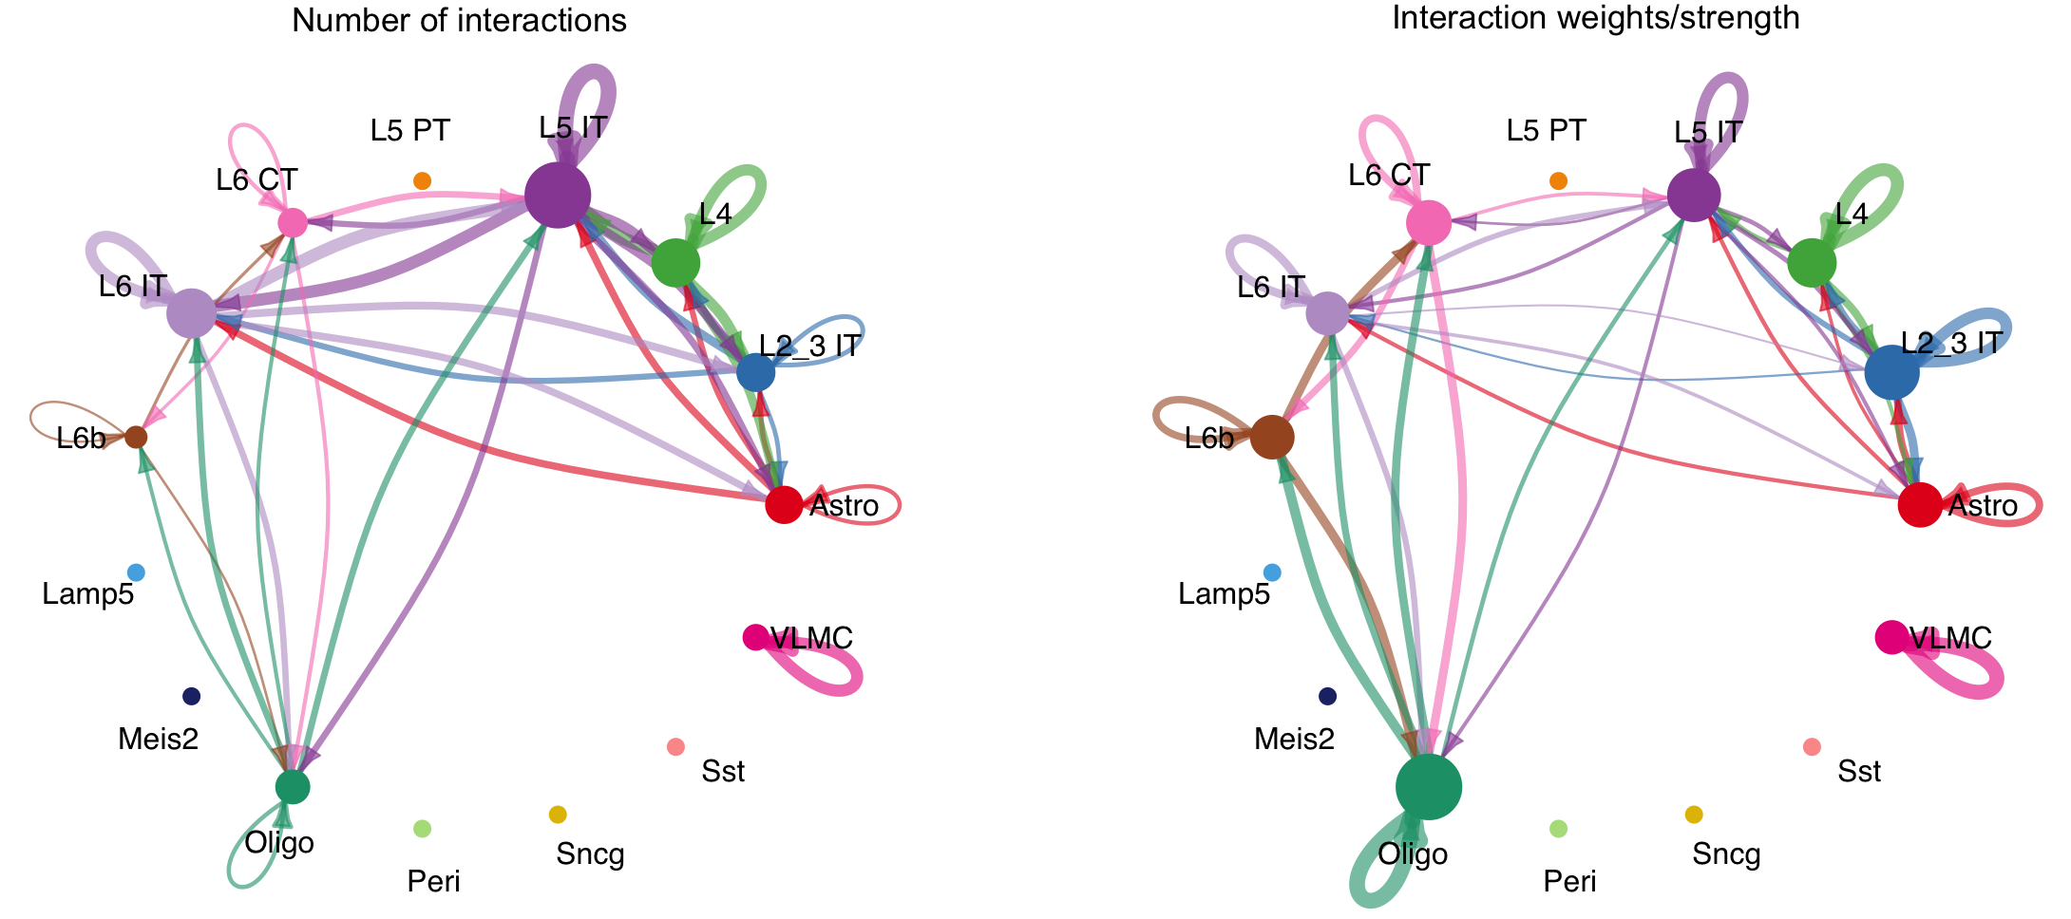
Visualization of the aggregated cell-cell communication network
Load dataset
Preprocessing
Inference of cell-cell communication network
Visualization network
par(mfrow = c(1,2), xpd=TRUE)
netVisual_circle(cellchat@net$count, vertex.weight = rowSums(cellchat@net$count), weight.scale = T, label.edge= F, title.name = "Number of interactions")
netVisual_circle(cellchat@net$weight, vertex.weight = rowSums(cellchat@net$weight), weight.scale = T, label.edge= F, title.name = "Interaction weights/strength")

Slide 76
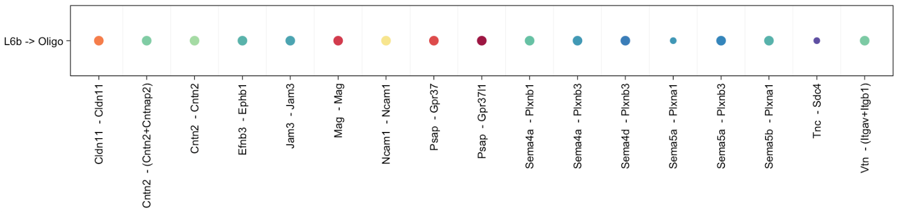
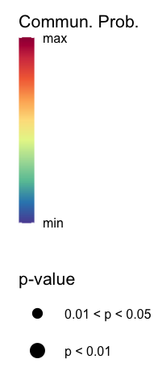
Identify ligand-receptor pairs between L6b and Oligo
Load dataset
Preprocessing
Inference of cell-cell communication network
Visualization network
CellChat::netVisual_bubble(cellchat, sources.use = c(8), targets.use =c(11), remove.isolate = FALSE, angle.x = 90,thresh = 0.05) +coord_flip()
Levels | Labels | Levels | Labels
1 | Astro | 9 | Lamp5
2 | L2_3 IT | 10 | Meis2
3 | L4 | 11 | Oligo
4 | L5 IT | 12 | Peri
5 | L5 PT | 13 | Sncg
6 | L6 CT | 14 | Sst
7 | L6 IT | 15 | VLMC
8 | L6b

Slide 77
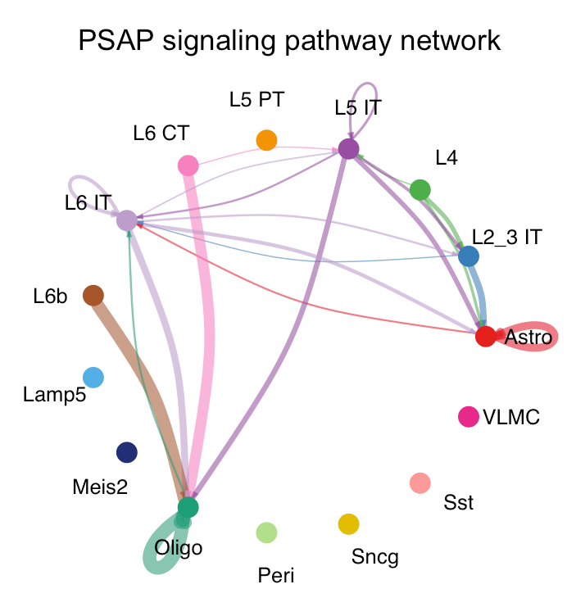
Inferred communication network of signaling pathways – Circle plot
Load dataset
Preprocessing
Inference of cell-cell communication network
Visualization network
pathways.show = c(”PSAP")
par(mfrow=c(1,1))
netVisual_aggregate(cellchat, signaling = pathways.show, layout = "circle")

Slide 78
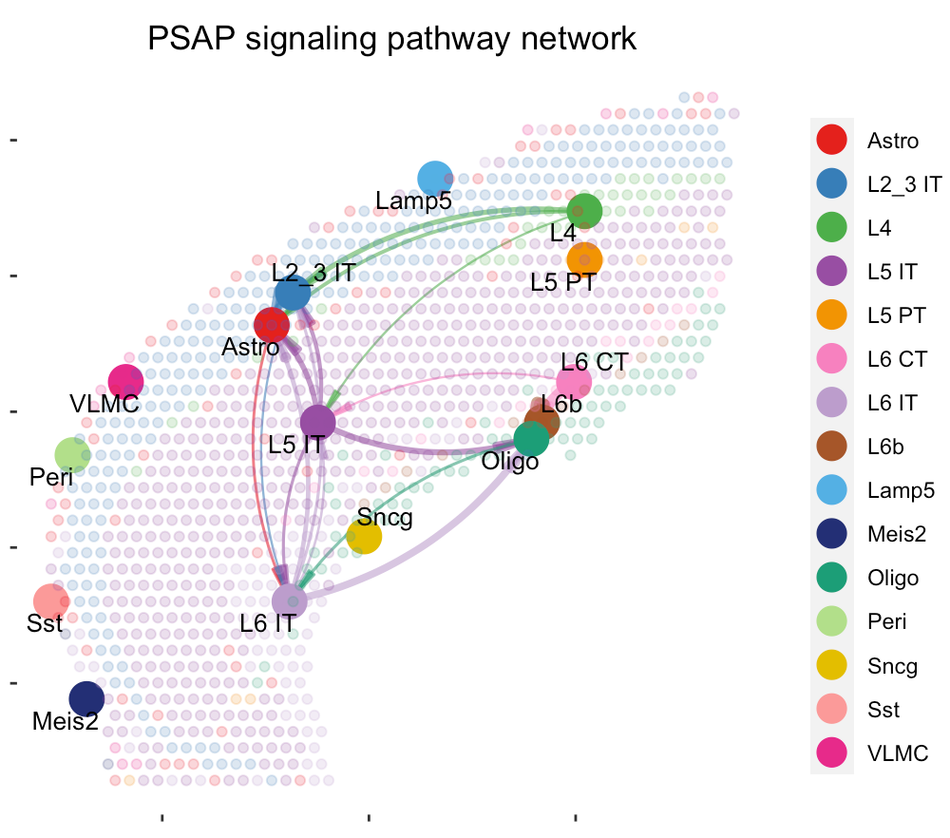
Inferred communication network of signaling pathways – Spatial plot
Load dataset
Preprocessing
Inference of cell-cell communication network
Visualization network
par(mfrow=c(1,1))
# Visualization information on the spatial imaging
netVisual_aggregate(cellchat, signaling = pathways.show, layout = "spatial", edge.width.max = 2, vertex.size.max = 1, alpha.image = 0.2, vertex.label.cex = 3.5)

Slide 79
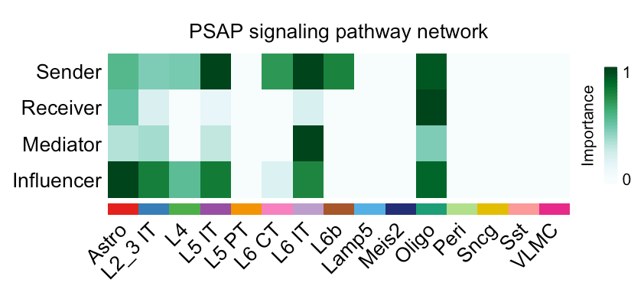
Compute the network centrality scores
Load dataset
Preprocessing
Inference of cell-cell communication network
Visualization network
# Compute the network centrality scores
cellchat = netAnalysis_computeCentrality(cellchat, slot.name = "netP")
# Visualize the centrality score
par(mfrow=c(1,1))
netAnalysis_signalingRole_network(cellchat, signaling = pathways.show, width = 8, height = 2.5, font.size = 10)
Visualize the computed centrality scores using heatmap, allowing ready identification of major signaling roles of cell groups

Slide 80
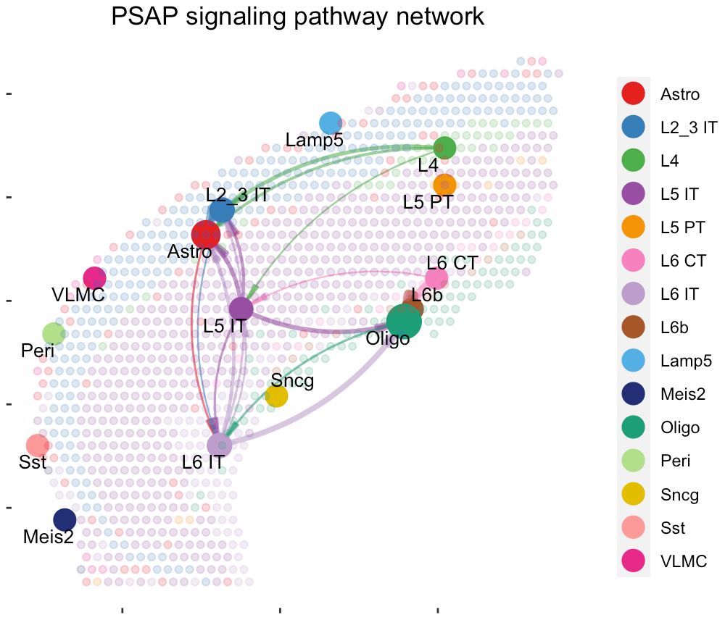
Load dataset
Preprocessing
Inference of cell-cell communication network
Visualization network
Visualize the network centrality scores - Spatial plot
# Visualize the network centrality scores on the spatial imaging.
par(mfrow=c(1,1))
netVisual_aggregate(cellchat, signaling = pathways.show, layout = "spatial", edge.width.max = 2, alpha.image = 0.2, vertex.weight = "incoming", vertex.size.max = 3, vertex.label.cex = 3.5)
Bigger circle indicates larger incoming signaling.
Incoming and outgoing signal can be visualized.
Incoming signaling : vertex.weight='incoming'
Outgoing signaling : vertex.weight='outgoing'

Slide 81
9. Visualization of multi-feature
blended spatial plot - STutility

Slide 82
Download spaceranger output
Construct STutility object
Blended Spatial Feature Plot
Download dataset for STutility
# Terminal
$ curl -O https://cf.10xgenomics.com/samples/spatial-exp/1.0.0/V1_Mouse_Brain_Sagittal_Anterior/V1_Mouse_Brain_Sagittal_Anterior_filtered_feature_bc_matrix.h5 # download
$ curl -O https://cf.10xgenomics.com/samples/spatial-exp/1.1.0/V1_Mouse_Brain_Sagittal_Anterior/V1_Mouse_Brain_Sagittal_Anterior_spatial.tar.gz
$ tar -xvzf V1_Mouse_Brain_Sagittal_Anterior_spatial.tar.gz

Slide 83
Download spaceranger output
Construct STutility object
Blended Spatial Feature Plot
Construct STutility object
# Set working directory to pre-downloaded directory (optional)
setwd('BIML_visium_STutility_input_files')
infoTable = data.frame(samples = c("./V1_Mouse_Brain_Sagittal_Anterior_filtered_feature_bc_matrix.h5"),
spotfiles = c("./spatial/tissue_positions_list.csv"),
imgs = c("./spatial/tissue_hires_image.png"),
json = c("./spatial/scalefactors_json.json"), stringsAsFactors=FALSE)
Mouse_Brain_STutility = InputFromTable(infotable = infoTable, platform = "Visium")
# Function used to read HE images in jpeg or png format
Mouse_Brain_STutility = LoadImages(Mouse_Brain_STutility,
time.resolve = FALSE, verbose = TRUE)

Slide 84
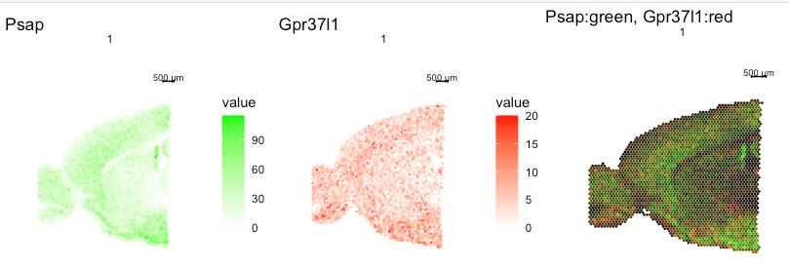
Ligand and Receptor Feature Plot
Download spaceranger output
Construct STutility object
Blended Spatial Feature Plot
plot_grid(
ST.FeaturePlot(Mouse_Brain_STutility, features = c("Psap"), cols=c("white","green")),
ST.FeaturePlot(Mouse_Brain_STutility, features = c("Gpr37l1"), cols=c("white","red")),
ST.FeaturePlot(Mouse_Brain_STutility, features = c("Psap","Gpr37l1"), blend=TRUE,channels.use=c("green","red")), ncol=3)
saveRDS(Mouse_Brain_STutility, "./BIML_visium_cortex_stutility.rds")

Slide 85
10. Summary

Slide 86
Summary
10X Genomics Visium sequence data & High-resolution microscope images of tissues
spaceranger count
Gene-Spot matrix
Seurat
Integrative analysis of spatial datasets
Seurat, SpaceXR
Deconvolution and Mapping Analysis
Squidpy
CellChat
Neighborhood analysis and co-occurrence
Cell-Cell interaction
STutility
Visualization of blended spatial data

Slide 87
Reference
Space Ranger
Zheng, Grace X.Y., Terry, Jessica M., [...] Bielas, Jason H. (2017). Massively parallel digital transcriptional profiling of single cells. Nature Communications. 8: 1-12, doi:10.1038/ncomms14049
Seurat
Hao Y, Hao S, Andersen-Nissen E, III WMM, Zheng S, Butler A, Lee MJ, Wilk AJ, Darby C, Zagar M, Hoffman P, Stoeckius M, Papalexi E, Mimitou EP, Jain J, Srivastava A, Stuart T, Fleming LB, Yeung B, Rogers AJ, McElrath JM, Blish CA, Gottardo R, Smibert P, Satija R (2021). “Integrated analysis of multimodal single-cell data.” Cell. doi:10.1016/j.cell.2021.04.048, https://doi.org/10.1016/j.cell.2021.04.048
SpaceXR
Cable, Dylan M., et al. “Robust decomposition of cell type mixtures in spatial transcriptomics.” Nature Biotechnology 40.4 (2022): 517-526.
Squidpy
Palla, G., Spitzer, H., Klein, M. et al. Squidpy: a scalable framework for spatial omics analysis. Nat Methods 19, 171–178 (2022). https://doi.org/10.1038/s41592-021-01358-2
CellChat
Jin, S., Guerrero-Juarez, C.F., Zhang, L. et al. Inference and analysis of cell-cell communication using CellChat. Nat Commun 12, 1088 (2021). https://doi.org/10.1038/s41467-021-21246-9
Stutility
Bergenstråhle, J., Larsson, L. & Lundeberg, J. Seamless integration of image and molecular analysis for spatial transcriptomics workflows. BMC Genomics 21, 482 (2020). https://doi.org/10.1186/s12864-020-06832-3

Slide 88
11. Q&A

